Slide 1
CULTURAL-TEXTILE TOURISM IN ARMENIA

Slide 2
Why do the Armenian Textiles became an issue of destination for cultural tourism?
The oldest rug was found in Altai Territory-Pazyryk Rug -5th - 4th century BC (Armenian double knot, red color-Armenian Vordan Karmir, design is typical to Urartian Culture)
Armenian inscribed and dated rugs from the middle ages
Textile fragments inside of Armenian old manuscripts
Archaeological materials of found Textile fragments in History Museum of Armenia
Armenian churches altar curtains and ritual textiles of different periods and regions
Armenian embroidered and famous dragon rugs
Armenian needlework and unique parts of garments

Slide 3
Endless silence for decades...WHY ?
Armenian Textiles are owned and purchased by Turkey and then are represented as an heritage of Ottoman Period Culture (thousand pieces are on display in the department of Islamic Art both in Turkey’s and world museums)
Hundred years all the organizations and auctions, magazines and independent scholars were fed up by Turkey and Azerbaijan
This policy has strategic importance for Azerbaijan and they spend million dollars all around the world for spreading false information
Where was the Armenia?- …
No state policy, no money, less publications, a few interested people etc….

Slide 4
Actions…
“Armenian Knot’’, Traditions of Carpet Weaving Art-International Conference, November, Yerevan, Armenia, 2013
‘’Armenian Rugs and Textiles’’-An overview of Examples From Four Centuries’’-Exhibition in Vienna, Austria, 2014
Armenian Rugs Society’s Publications in USA
HALI TOUR ARMENIA, September, 2015

Slide 5
Wake up calls by…
Independent Armenian scholars both from Armenia and all around the world
Armenian Rugs Society from USA
Armenian Rugs Society from Europe
Armenia-Artsakh bridge
Support by The Ministry of Culture of RA
Latest publications and articles in English
International exhibitions

Slide 6
HALI Magazine- London, UK Famous International Magazine of World Textile, Oriental Rugs and Carpets
Since 1978 up to days…
HALI Issues-186 Vol.(4 times per year )
Activities –Magazine, Auctions, Exhibitions, Publications, Tours etc…
http://www.hali.com/

Slide 7
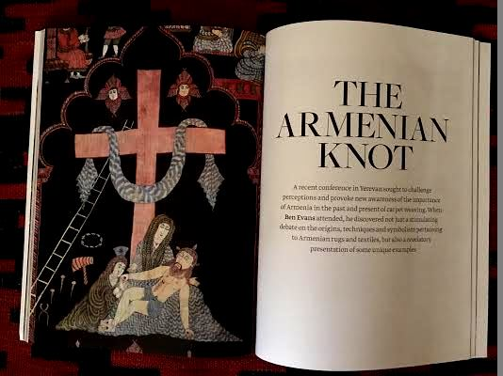
Articles in HALI SPRING 2014 issue - HALI Magazine
Written by Ben Evans

Slide 8
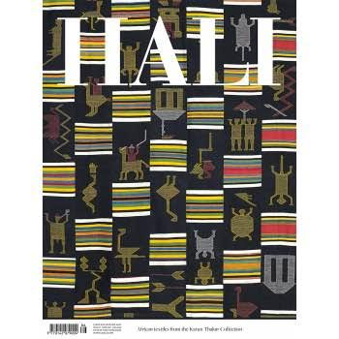
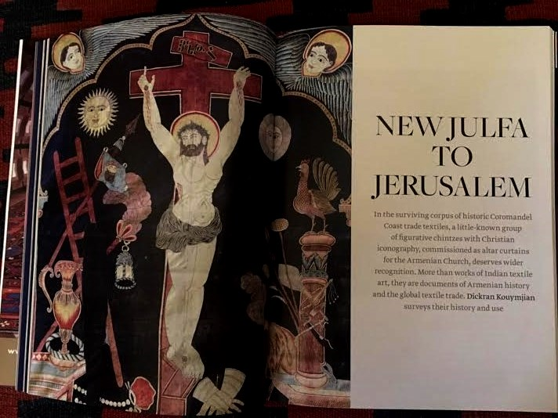
Articles in HALI WINTER 2015 issue - HALI Magazine
Written by Dickran Kouymjian

Slide 9
The first HALI TOUR ARMENIA, September, 2015

Slide 10
Implemented by Tatev Muradyan (ethnographer, scientific researcher at H. Sharambeyan Centre of Popular Creation-Ministry of Culture of RA) and
Vladimir Grigoryan-Director of DA Tours
http://www.da-tours.com/

Slide 11
Deliberate year-2015
The region is integral to the history of rugs and textiles, both in terms of production and trade. 2015 is an important year for the Armenian nation, with memorial services capturing the world’s attention.
BEN EVANS
Editor of HALI Magazine

Slide 12
Schedule and MAP

Slide 13
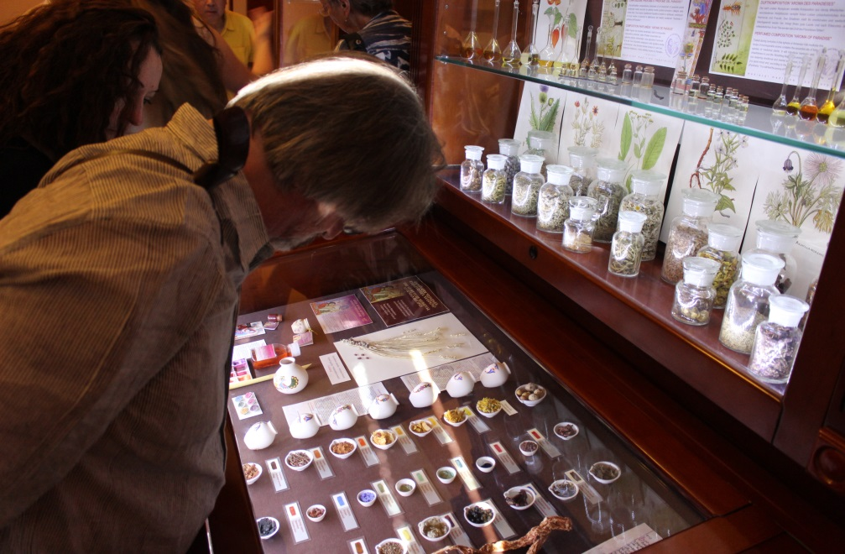
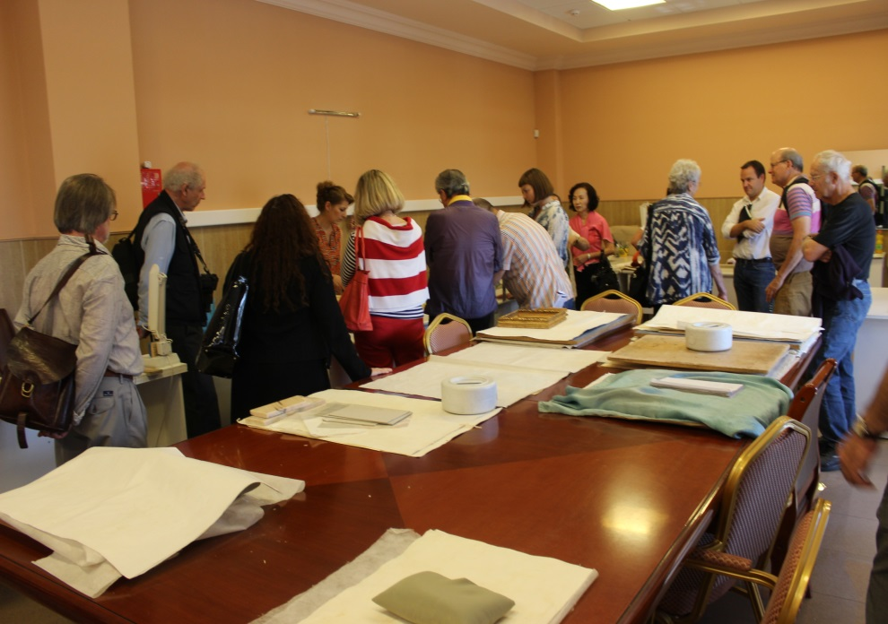
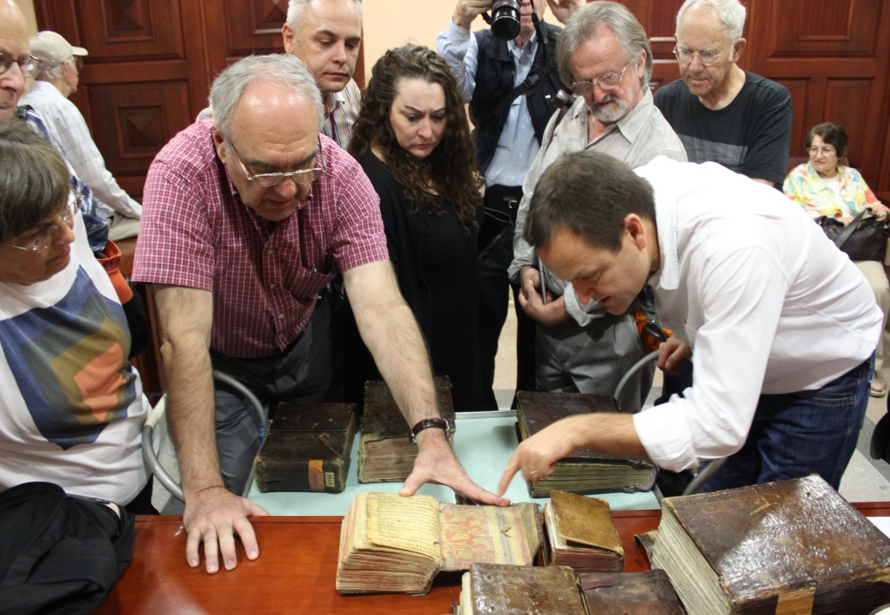
Matenadaran -Institute of Ancient Manuscripts

Slide 14
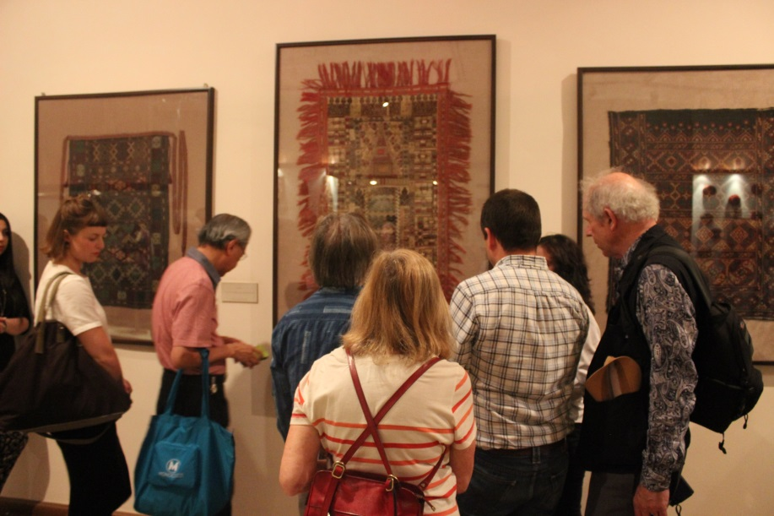
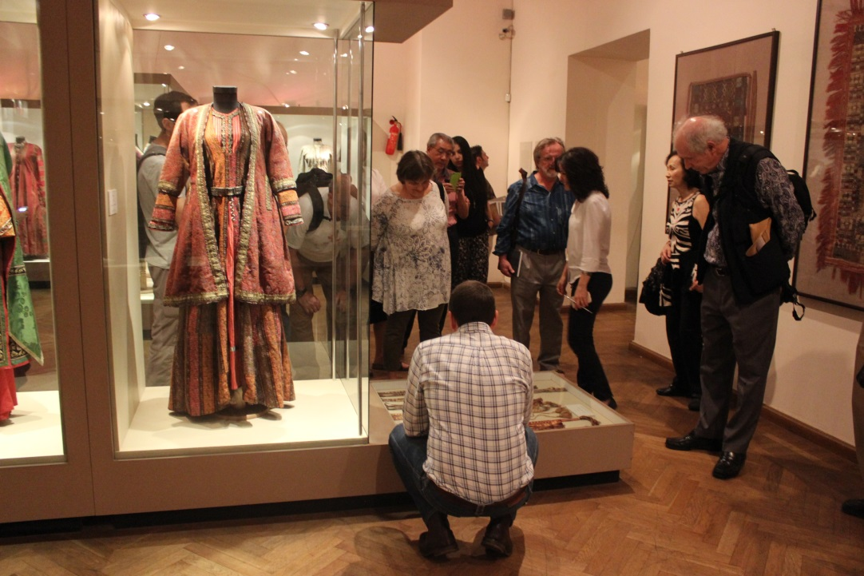
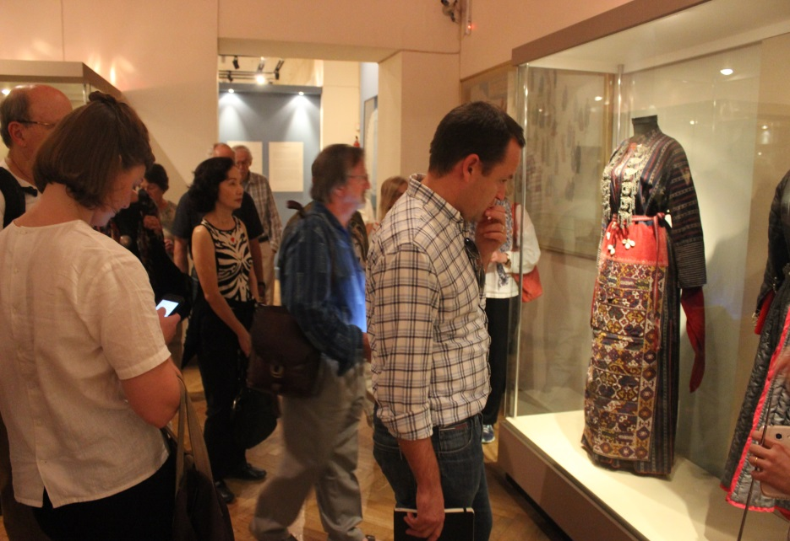
History Museum of Armenia

Slide 15
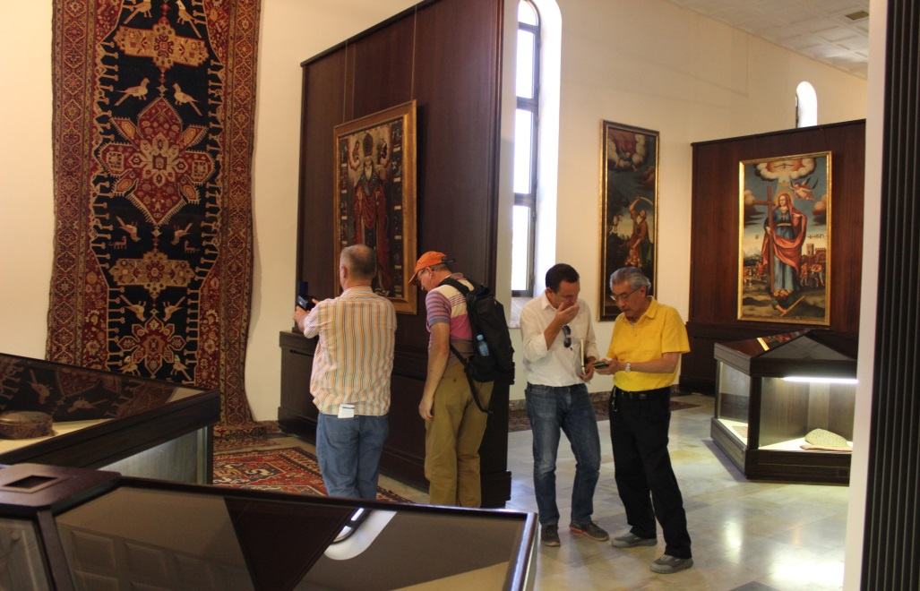
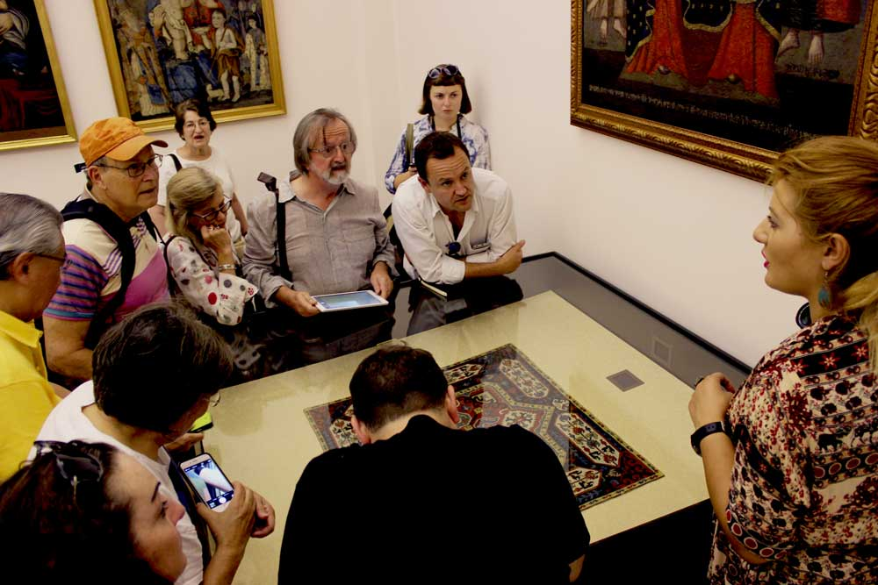
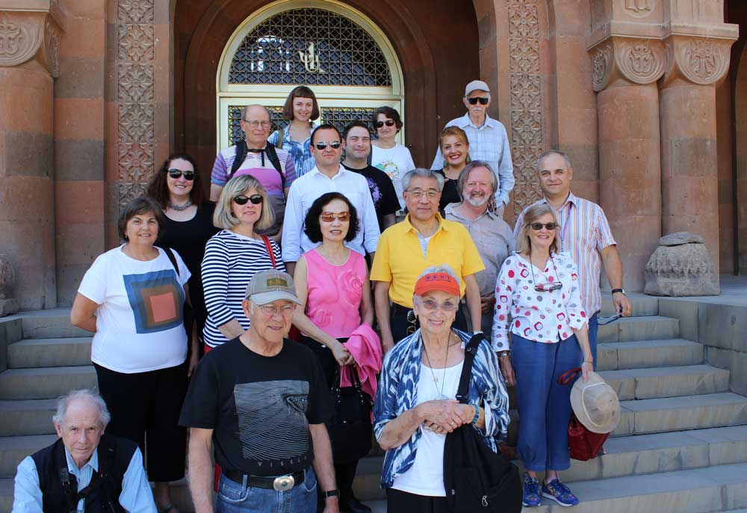
Treasury of Mother See of Holy Etchmiadzin

Slide 16
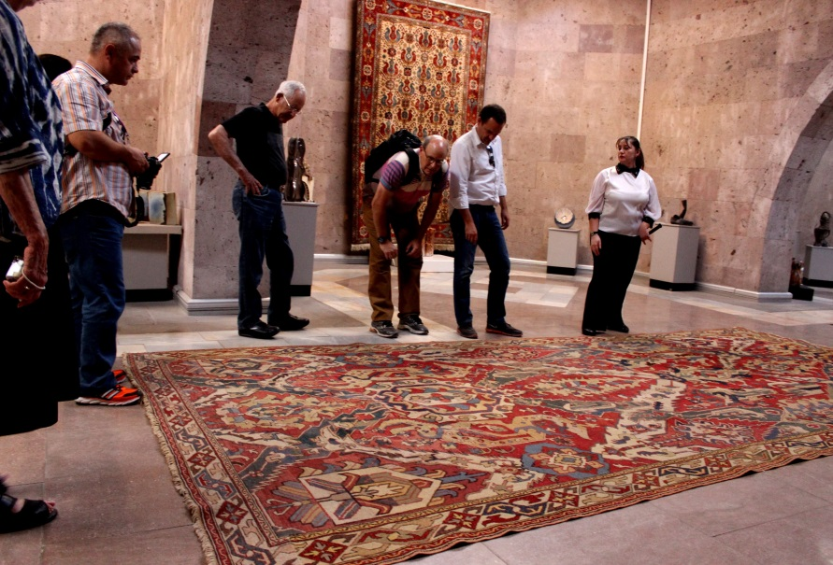
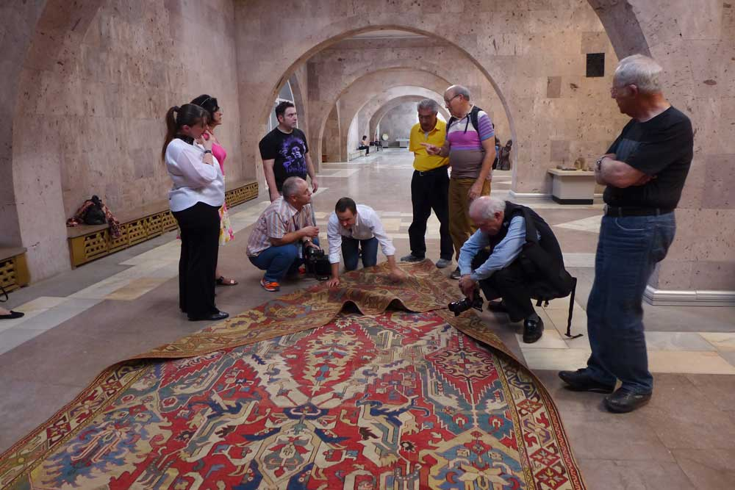
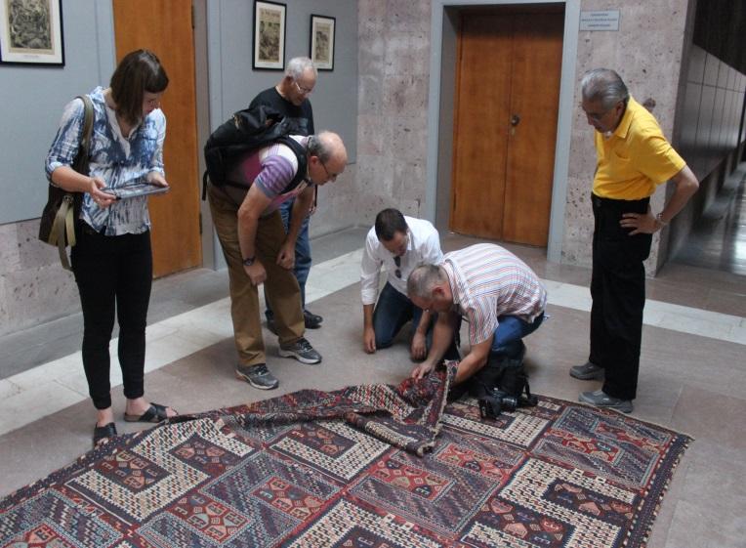
Sardarapat-Armenian Ethnographic Museum

Slide 17
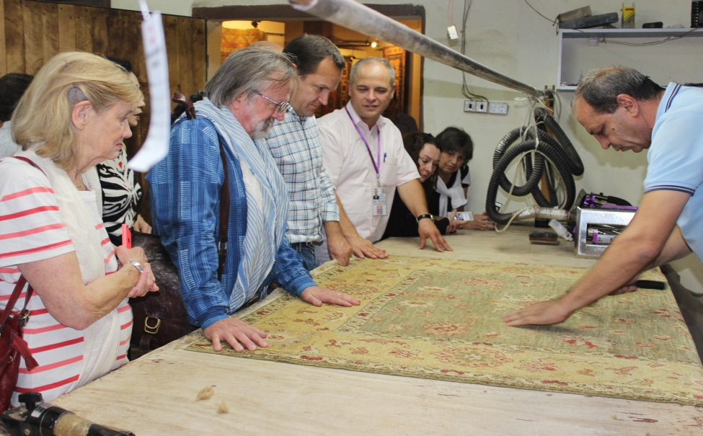
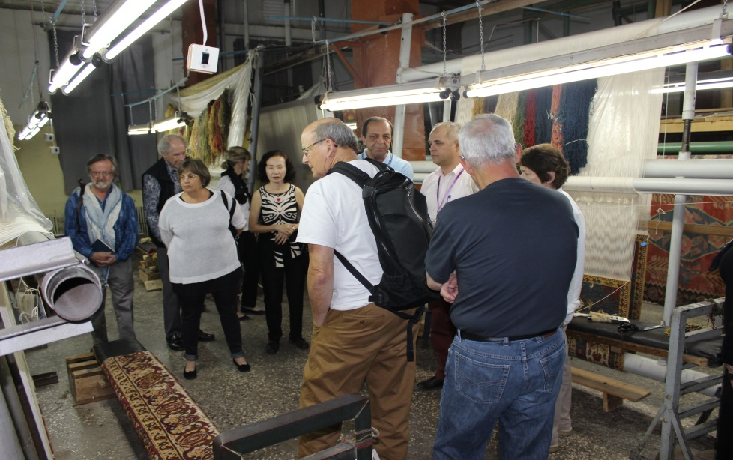
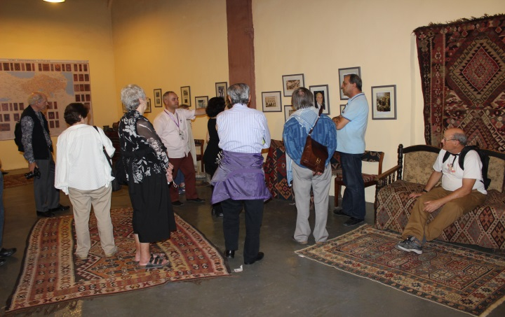
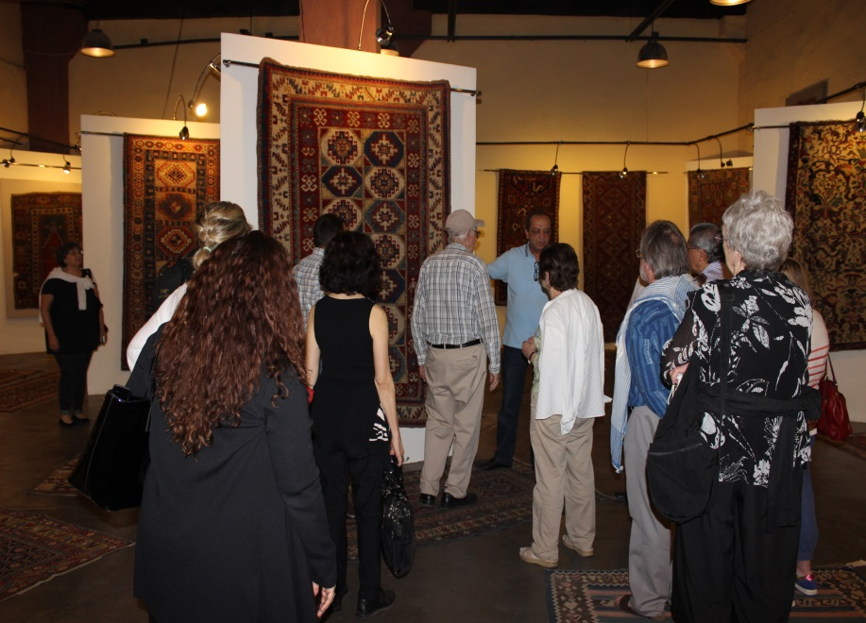
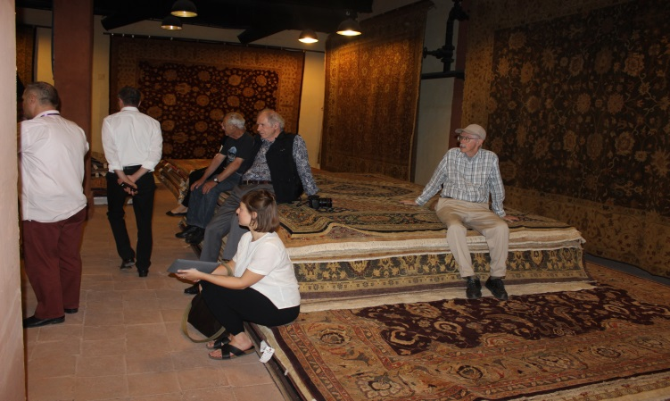
Megerian Carpet Factory

Slide 18
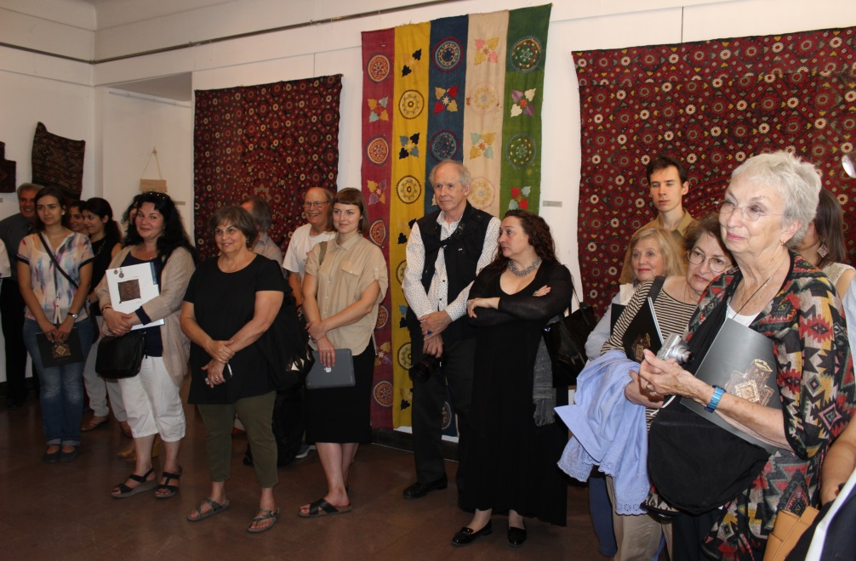
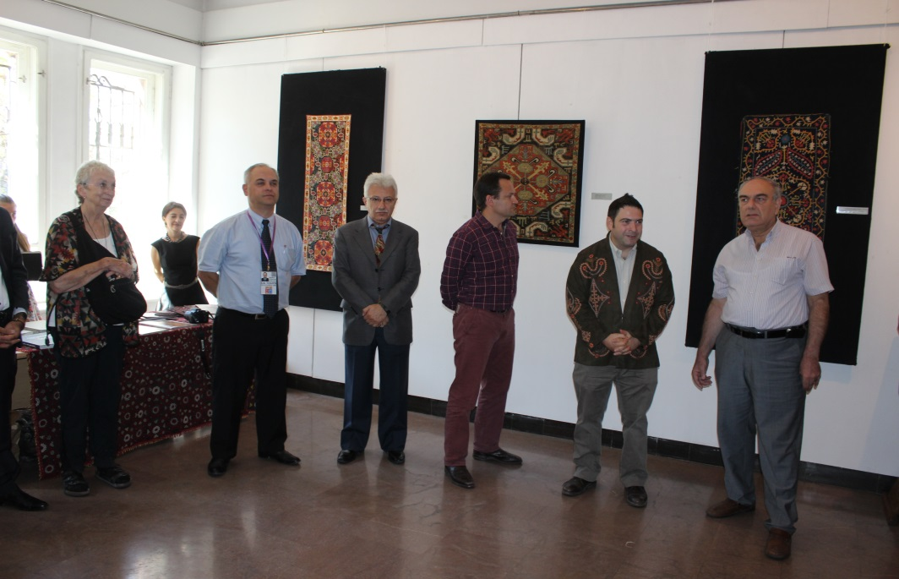
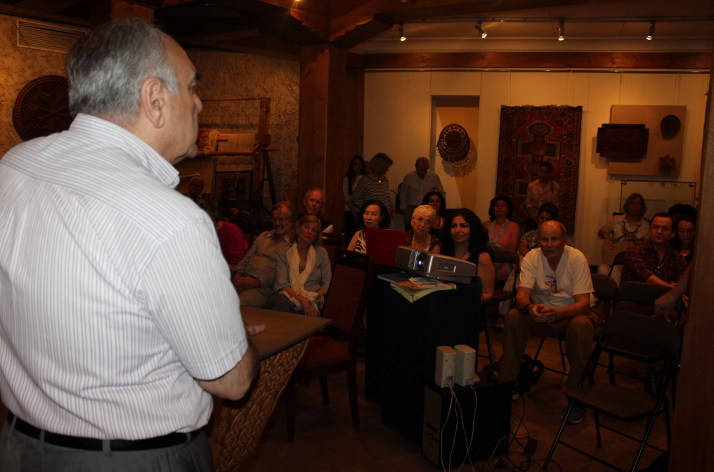
H.Sharambeyan Centre of Popular Creation (Folk Art Museum)

Slide 19
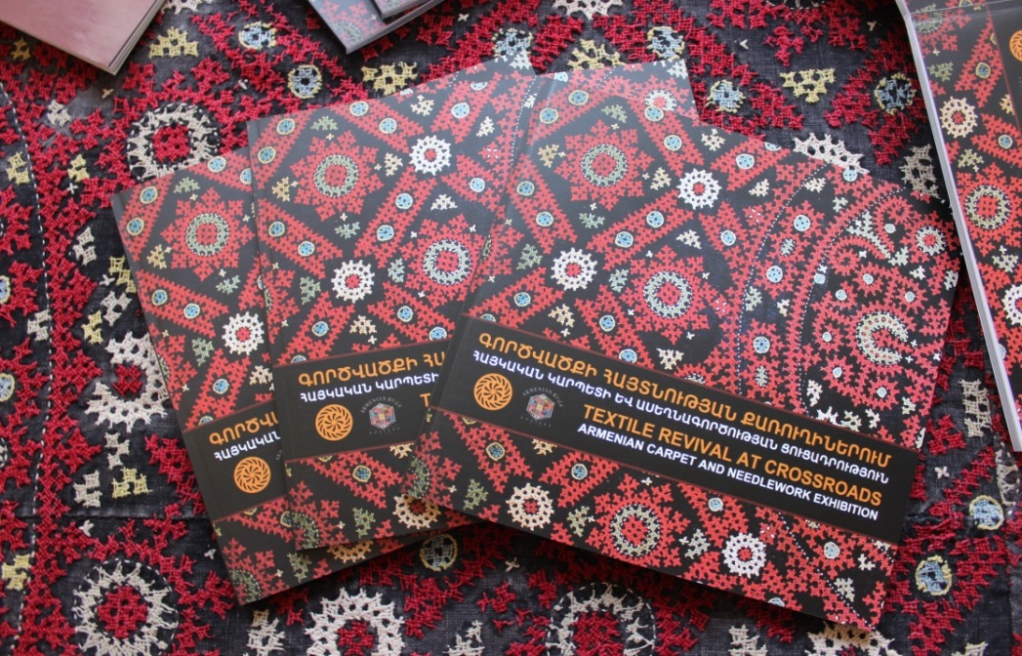
Catalogue was published within HALI Tour Armenia Under the sponsorship of Armenian Rugs Society

Slide 20
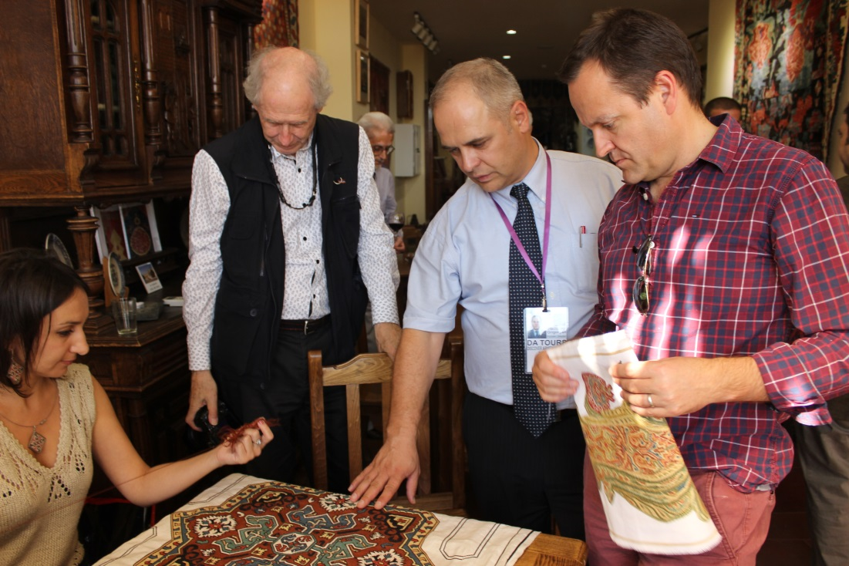
Master Class at Folk Arts “HUB” Foundation

Slide 21
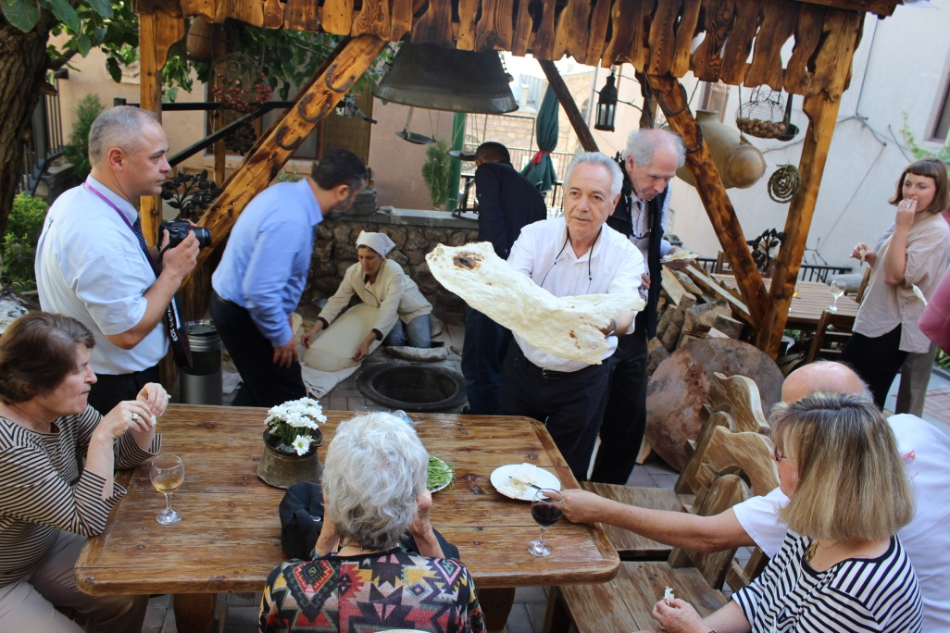
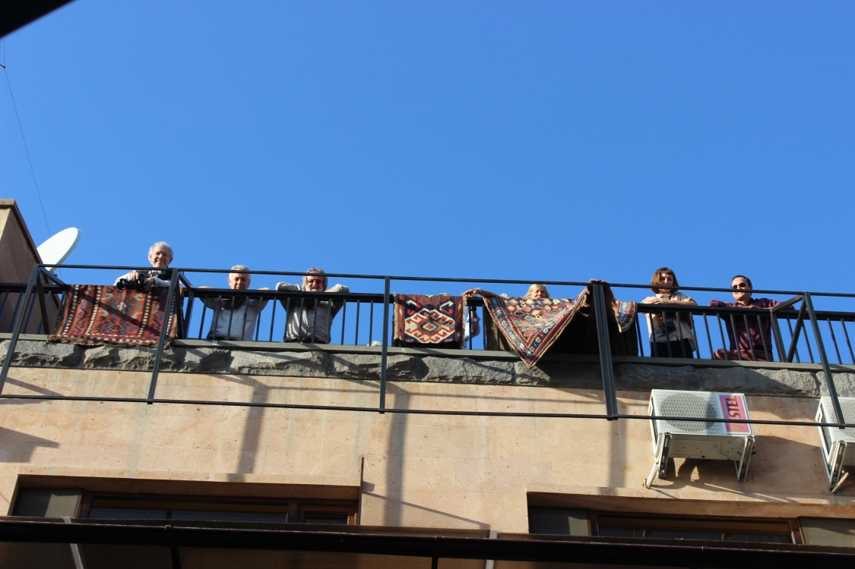
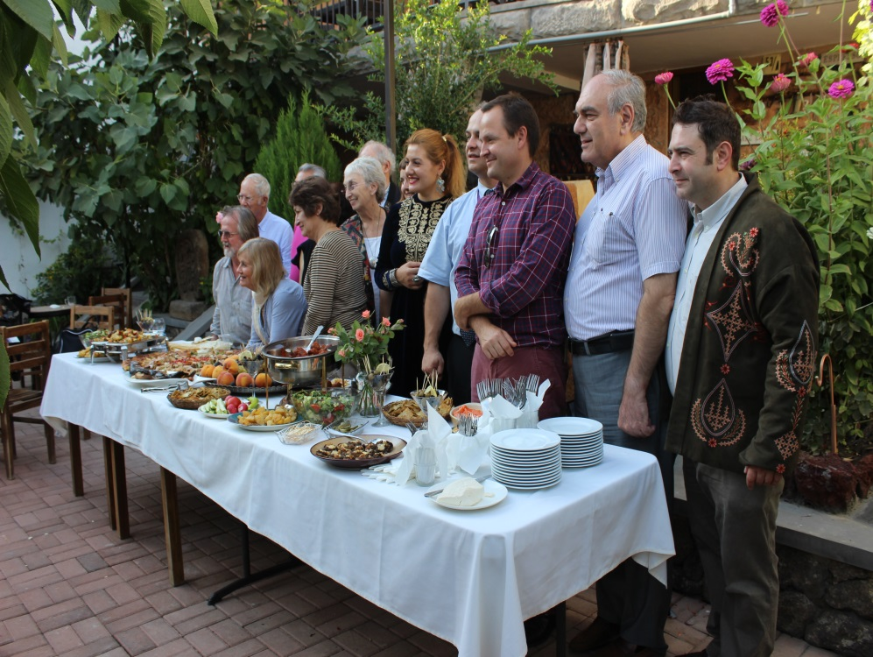
Cultural reception at Silk Road Hotel

Slide 22
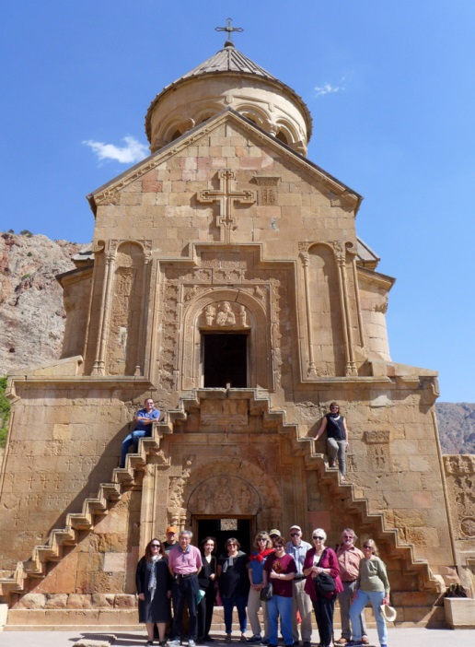
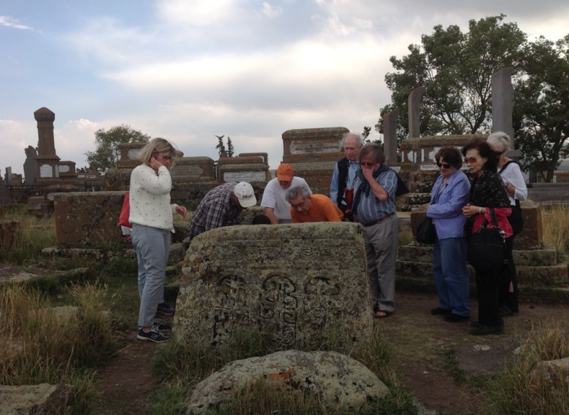
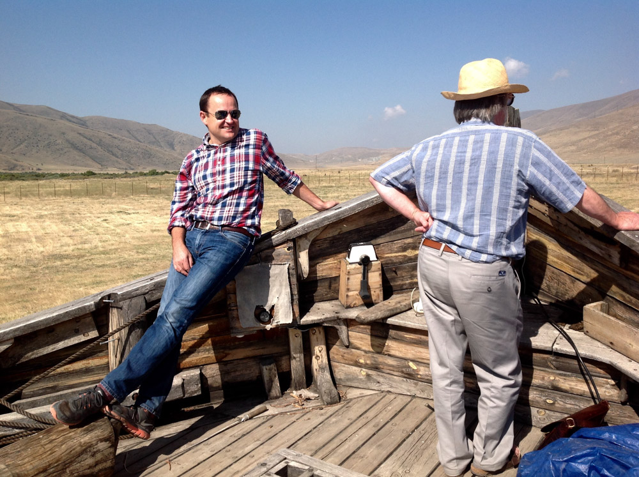
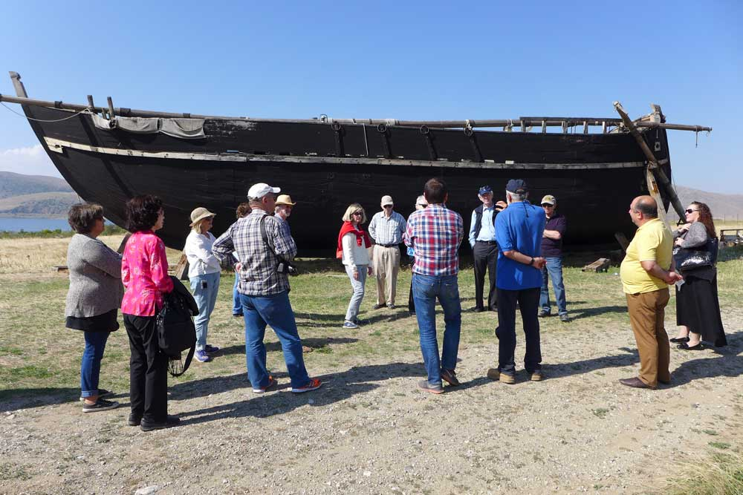
Exploring Armenia…

Slide 23
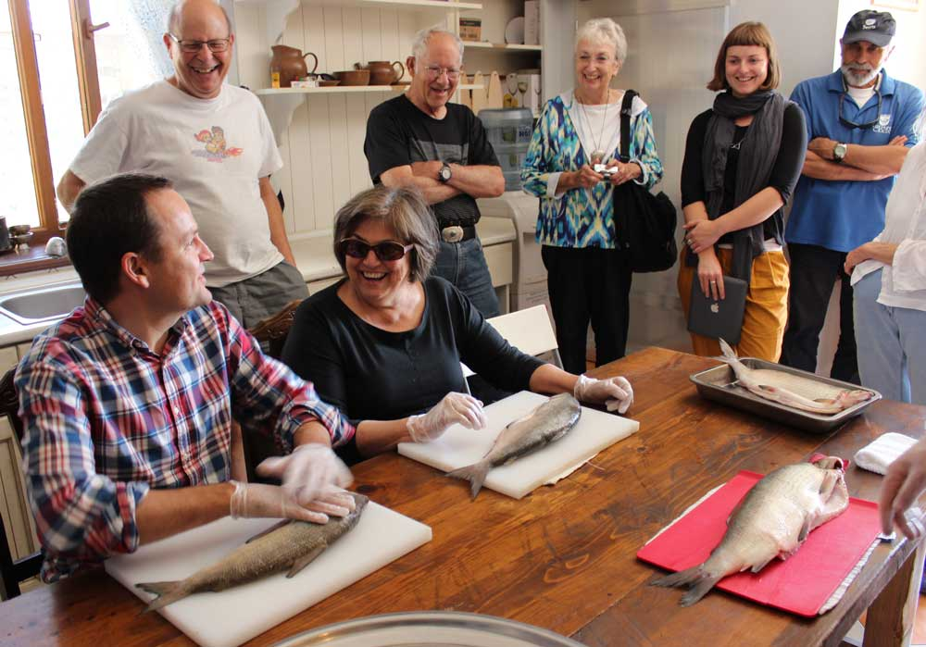
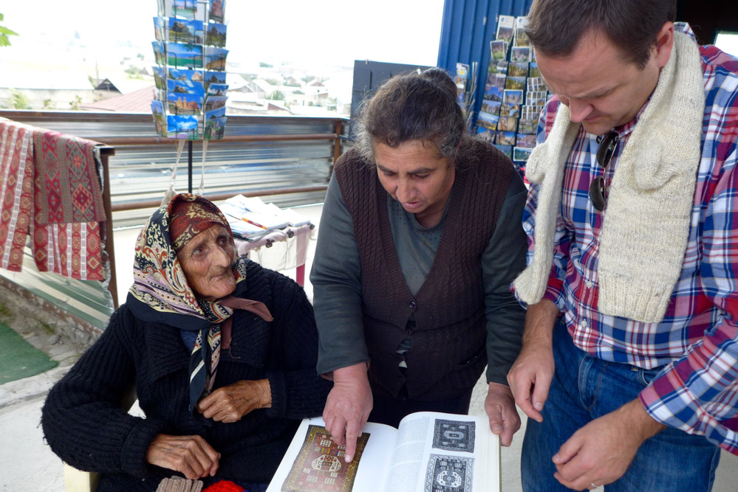
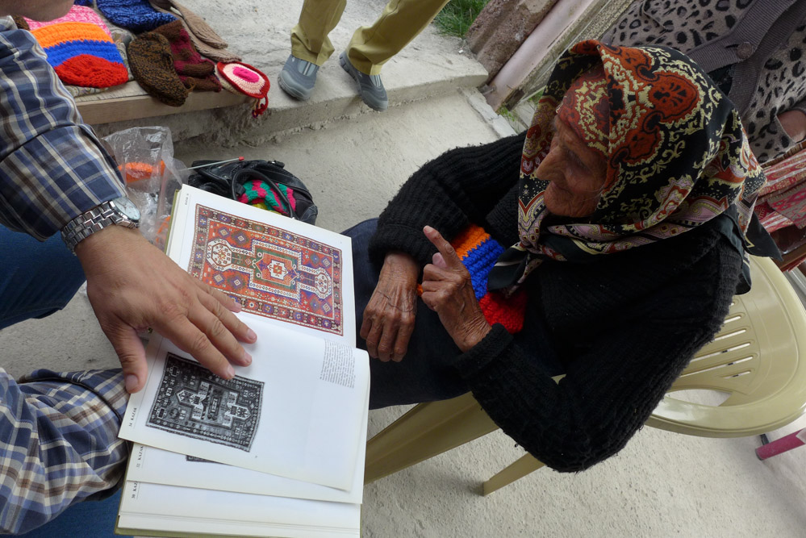

Slide 24
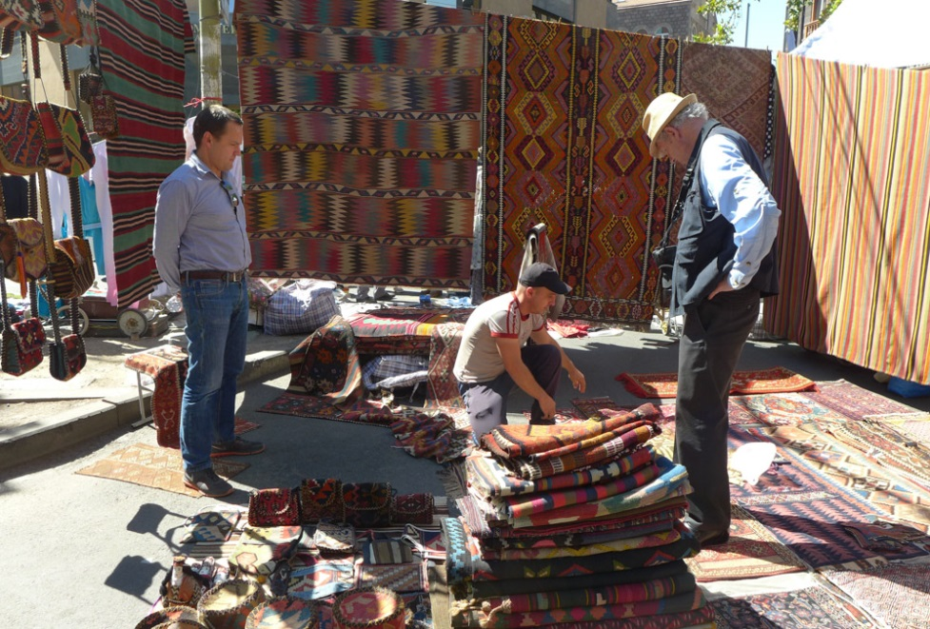
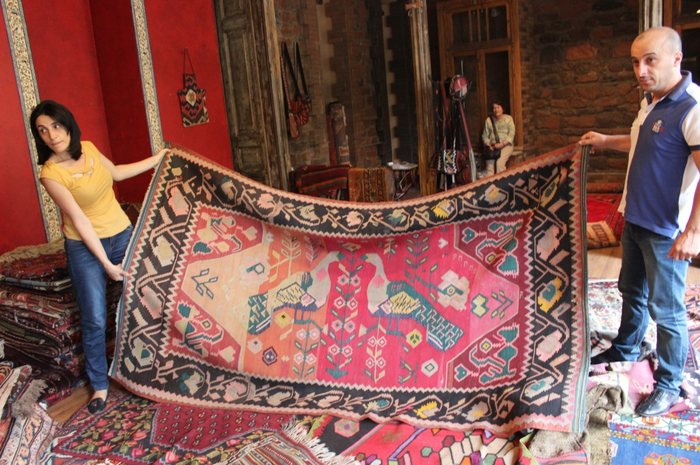
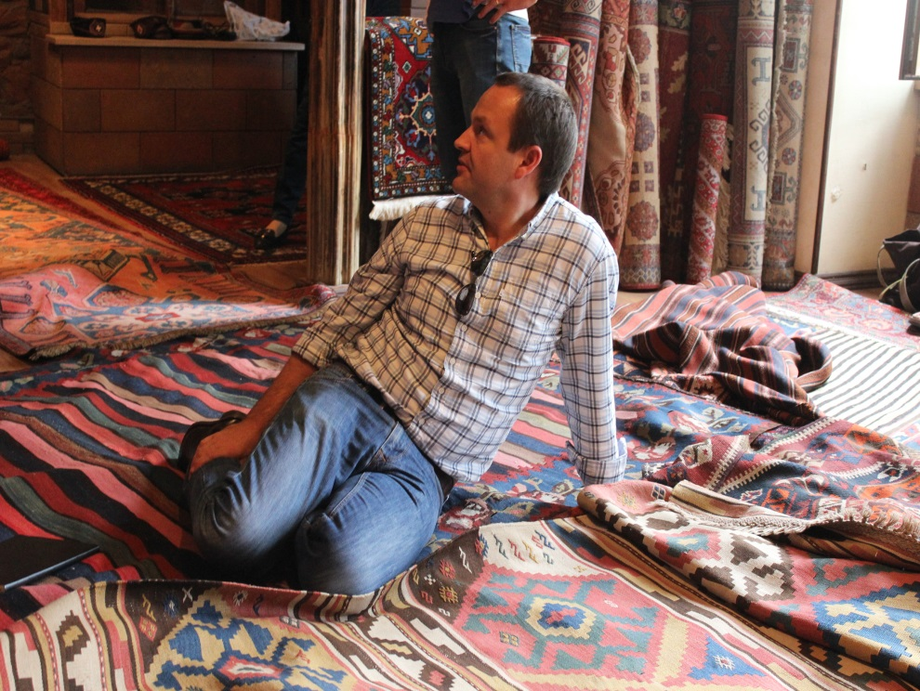
Visit Vernisage and private collectors

Slide 25
The next HALI Tour Armenia on May, 2016

Slide 26
The aim of Cultural Tour to Armenia
Promote Armenian culture and related old traditional crafts to the world
Enhance the Armenian textiles reputation of identity both in auctions and in private collections
By the others hands take back the identity and copyright of stolen Armenian cultural heritage by Muslims for centuries (Turkey, Azernaijan etc…)
Underline the international role of Armenian museums as a rare source in the field of antique culture science and study
Develop another field of tourism in Armenia
Armenian Handmade production-visit card of Armenia

Slide 27
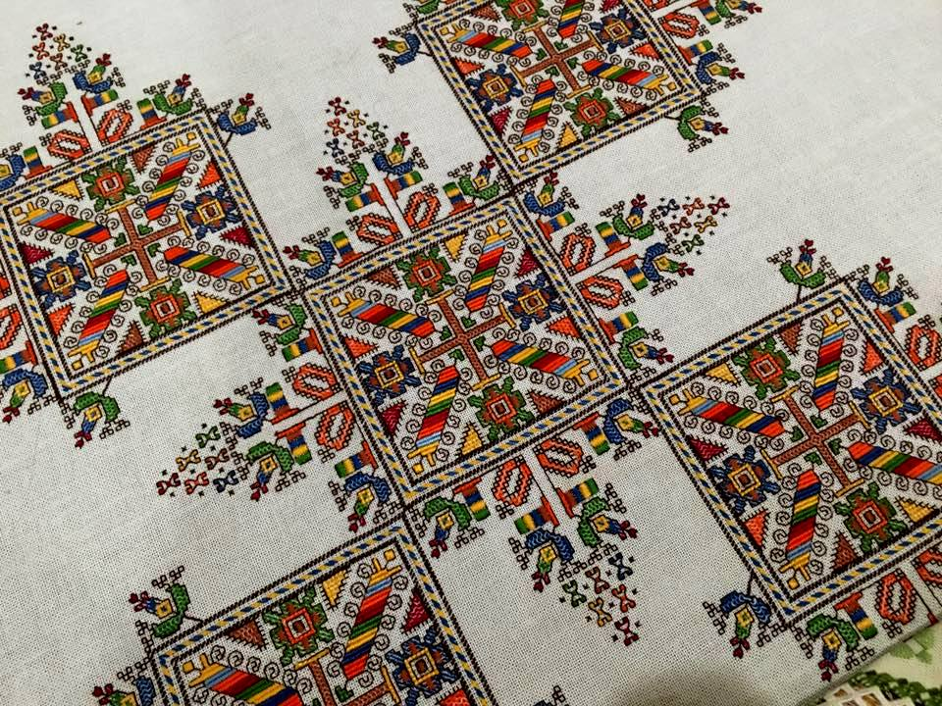
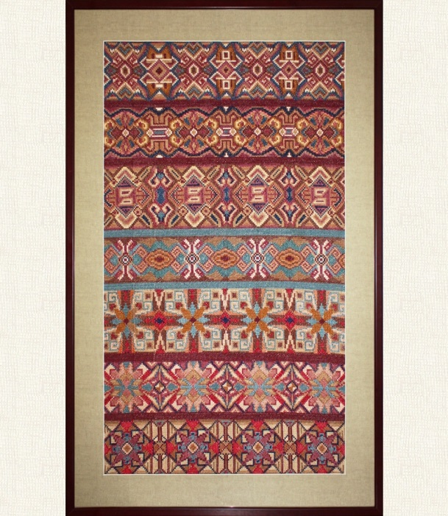
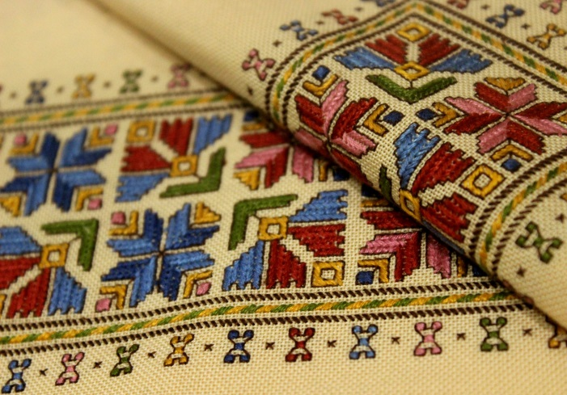
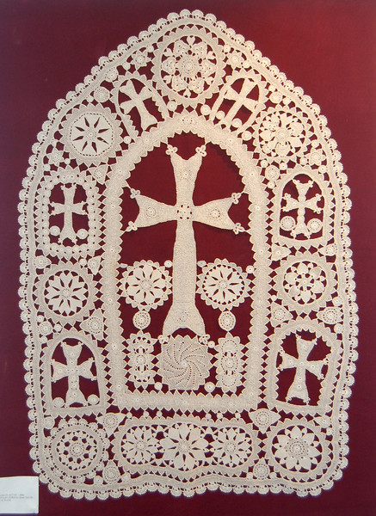
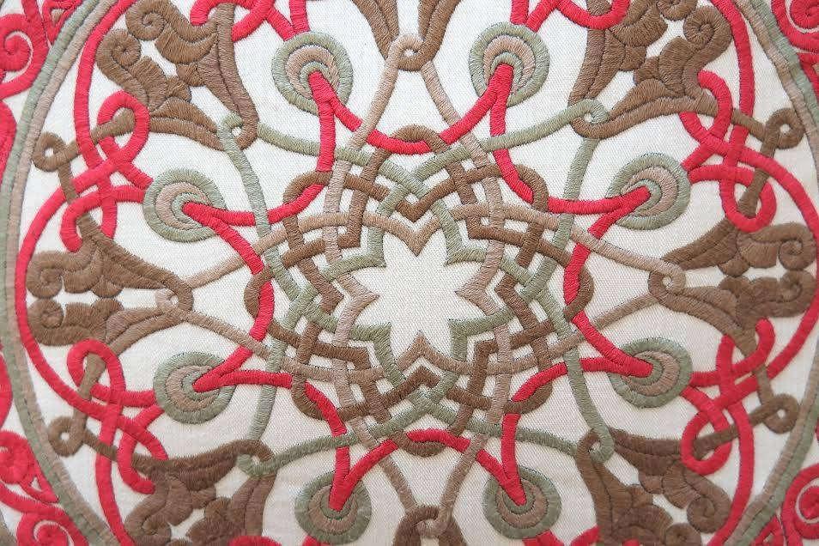
Modern Textiles, Handmade in Armenia

Slide 28
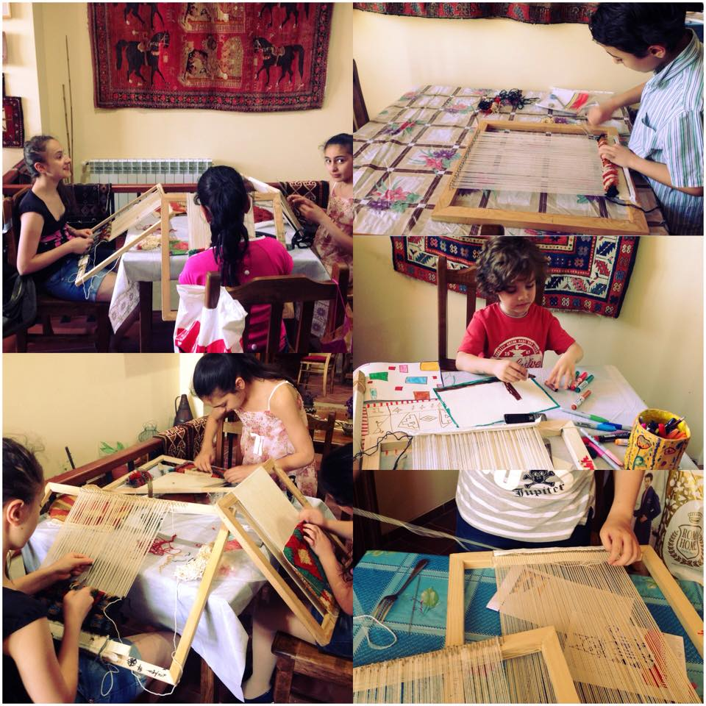
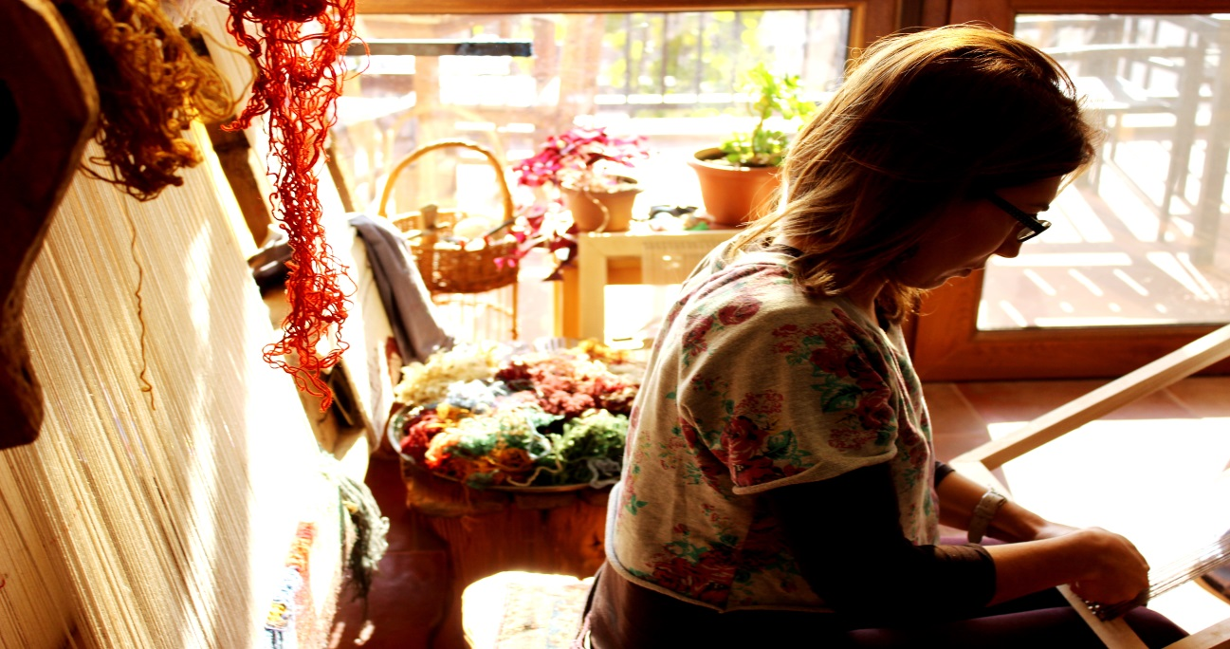
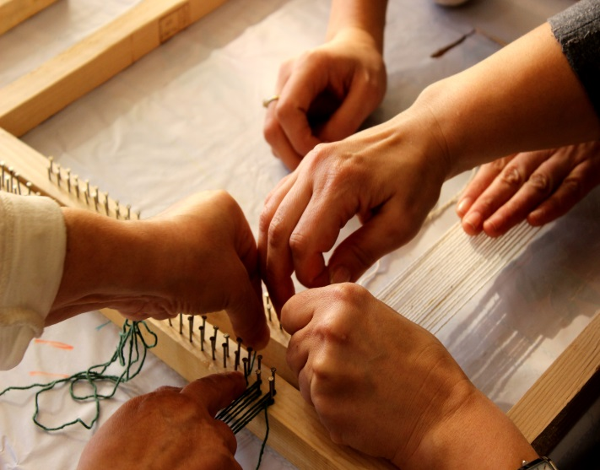
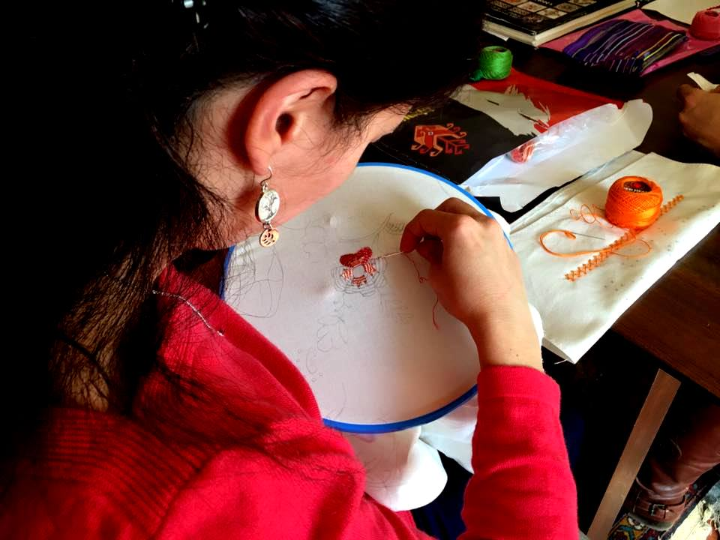
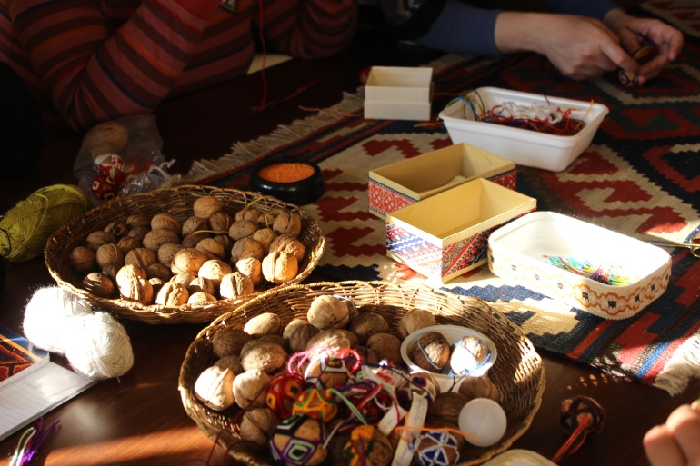
Preserving Armenian crafts
Folk Arts “HUB” Foundation at Silk Road Hotel

Slide 29
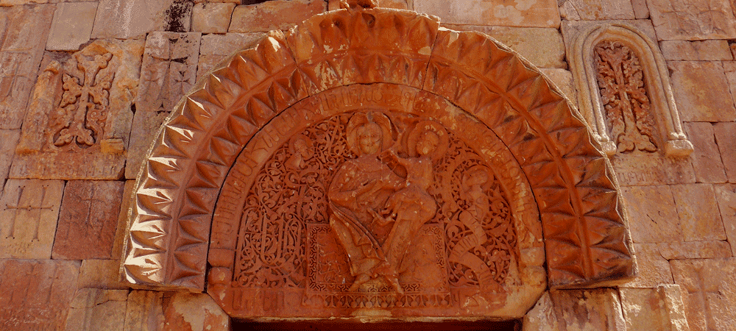
For you it’s a church, for us- an important source for the rare facts
The facade of Surb Karapet Church with a striking depiction of God the Father on carpet (upper relief), Noravank,13th century

Slide 30
RESULTS Other interests on Cultural Tourism in Armenia
Smithsonian Institute (USA)
ICOC (International Conference on Oriental Carpets)

Slide 31
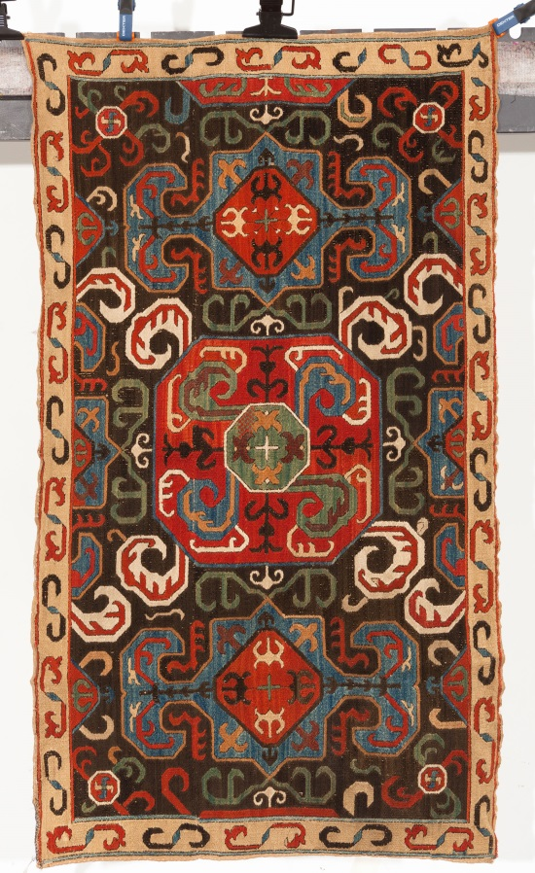
Armenian Embroidered rug from Artsakh (Karabakh), 18th century
Gros & Dolettrez Auction, 9-11 April, Paris
http://www.gros-delettrez.com/
SOS- We need sponsors for the purchase this rug
Estimate price-40.000-60.000Euro

Slide 32
Thank you Loving Armenia…
Tatev Muradyan
Director of Silk Road Hotel
and
Folk Arts “HUB” Foundation
Yerevan, 2016

