Slide 1
Welcome to

Slide 2
Why Tourism Matters for Developing World
economic lifeblood for small towns, historical districts and neighbourhoods
Source: World Tourism Organization

Slide 3
Why Self-Guided Tourism Matters
Thousands of tourists prefer self or semi-guided tours over guided experiences
Only 5% of walking tours happening in the world are guided
Source: PwC Global Entertainment & Media Outlook: 2013-2017 Source: World Tourism Organization Annual Report

Slide 4
Why Mobile Matters
By 2017 more than 3 billion people will have mobile internet access
Source: PwC Global Entertainment & Media Outlook: 2013-2017

Slide 5
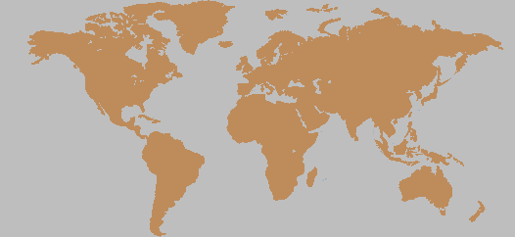
Problem 1: Building Tourism for Small Cities & Villages
Moose Jaw
Lofoten
Turku
Yellowknife
Rimouski
Porvoo
Visby
Pskov
Dawson Creek
Skane
Kareliya
Salmon Arm
Whitehorse
Nyhavn
Odense
Bibury
Leiden
Vladimir
Caledon
Canmore
Chichiliann
Hallstatt
Stratford
Camrose
Freirburg
Mtskheta
Omsk
Krasnoyarsk
Monsanto
Ljubljana
Khiva
Tarragona
Kefalonia
Manarola
Nijni Novgorod
Naramachi
Woods Hole
Chefchaouen
Shirakawa-go
Williamsburg
Dali
Wuyuan
Healdsburg
Chautauqua
Tripoli
Kanas
Steamboat
Pingyao
Bagan
Meghalaya
Taal
Ouro Preto
Broom
Launceston
San Pedro
Kalgoorlie
Pucon
Coober Pedy
Goolwa
Tilba
Kafayate
Port Douglas

Slide 6
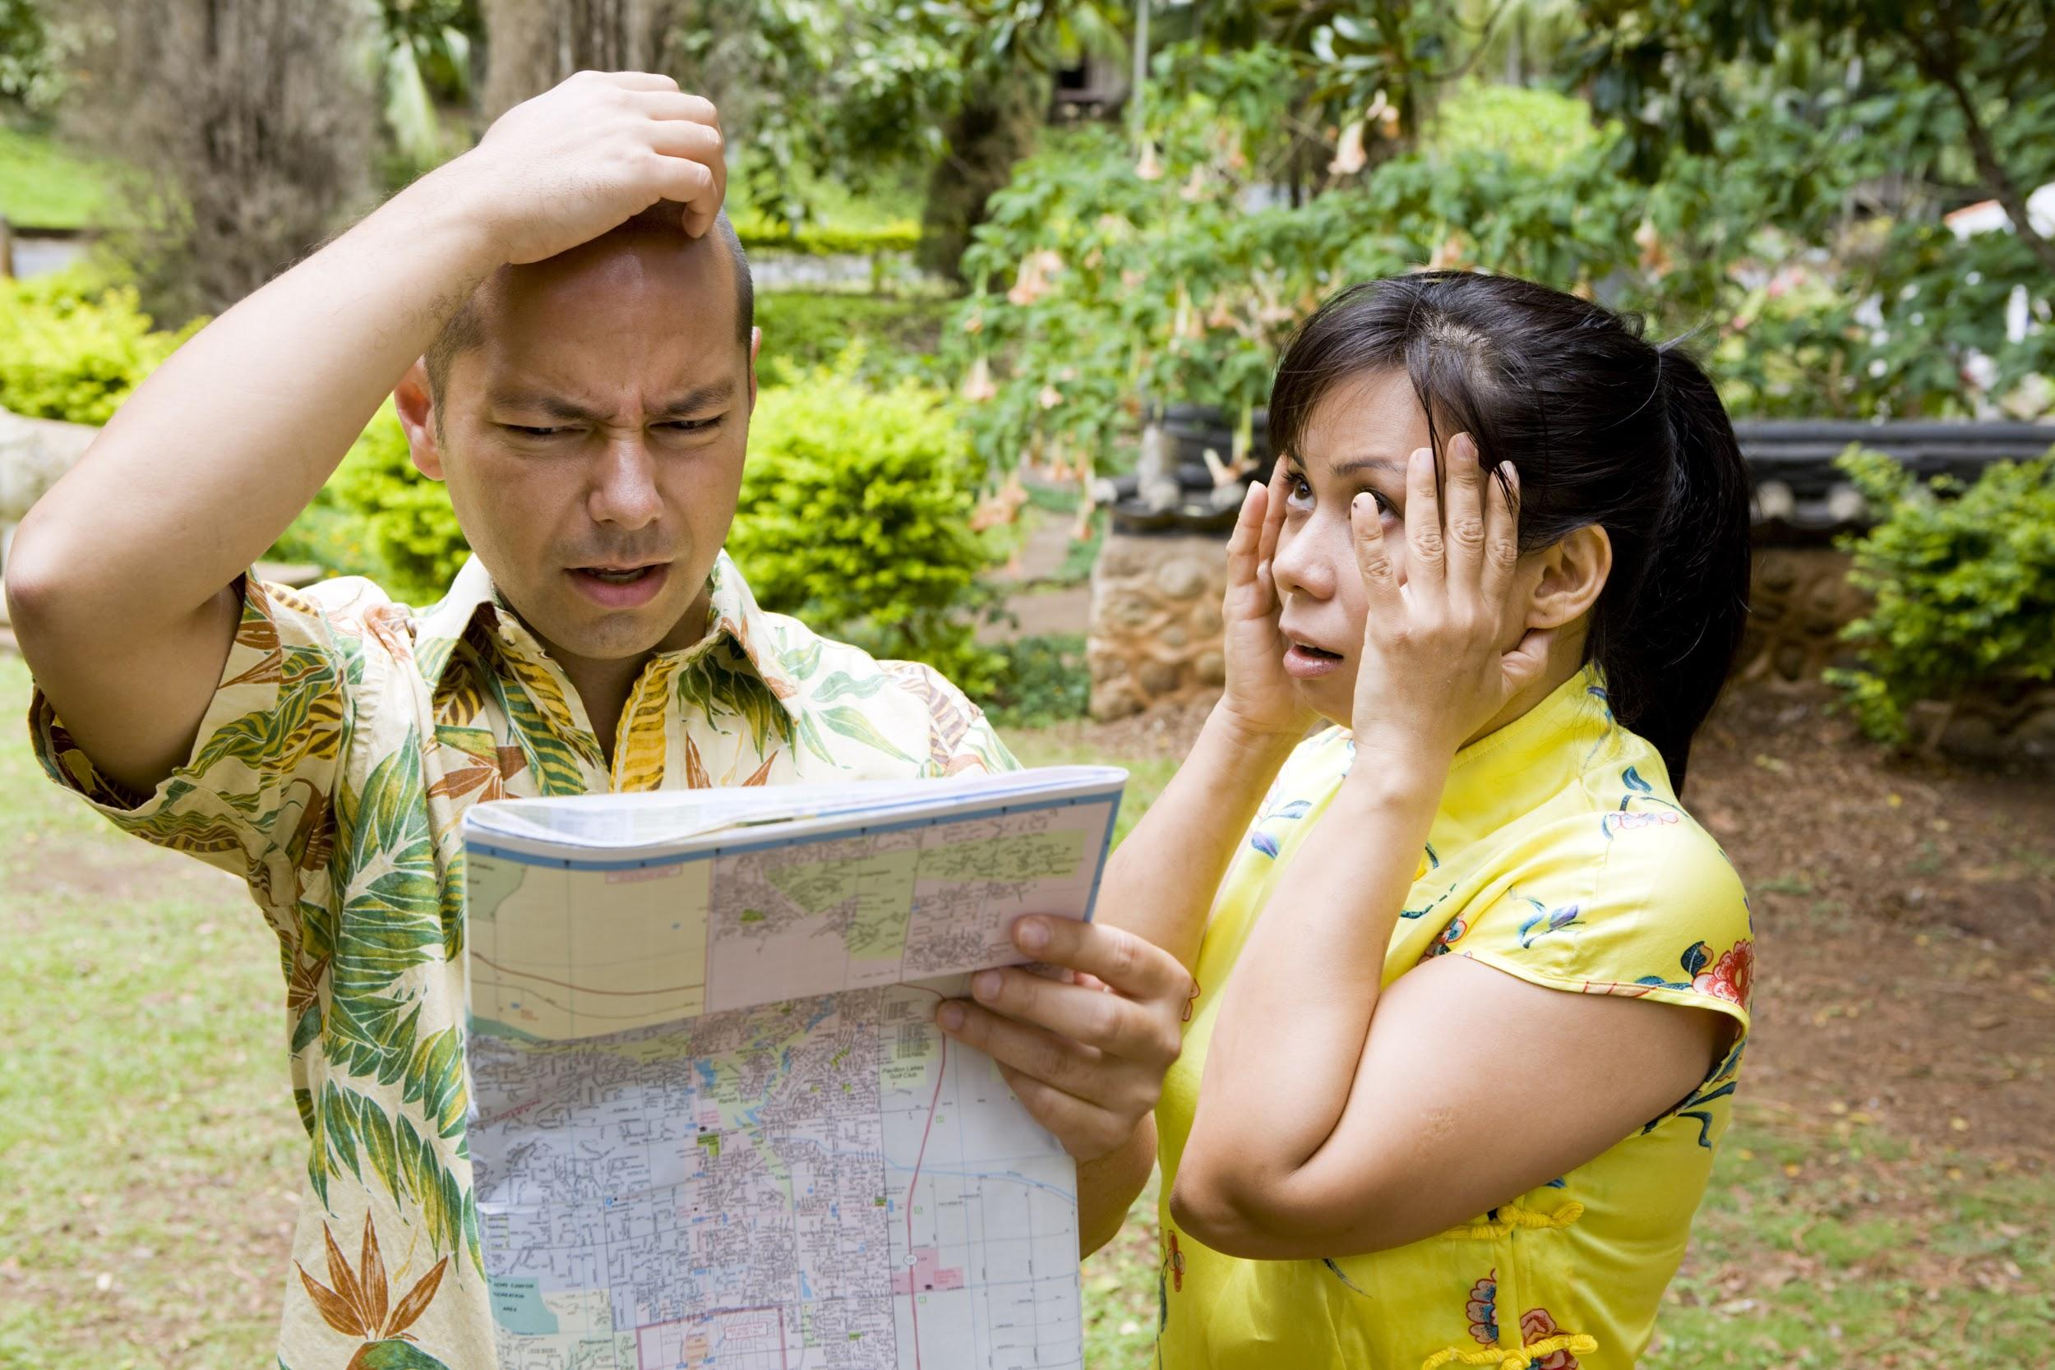
Problem 2: Give independent tourists guiding tools

Slide 7
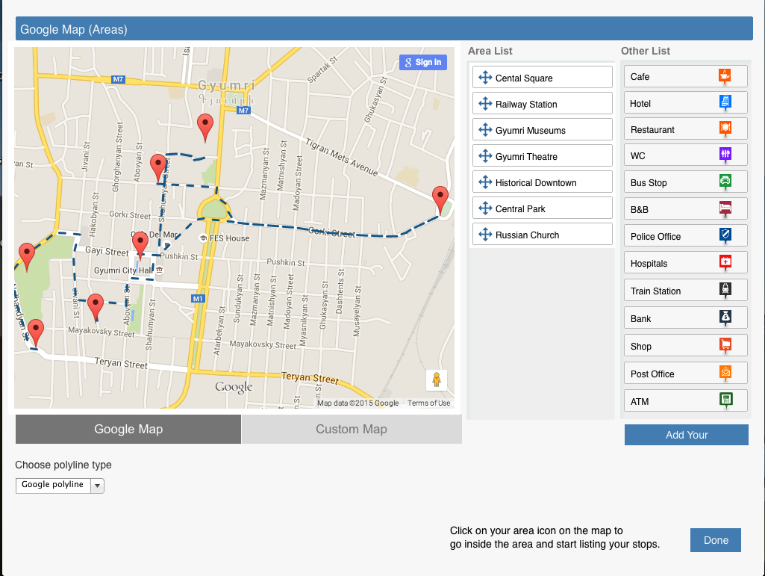
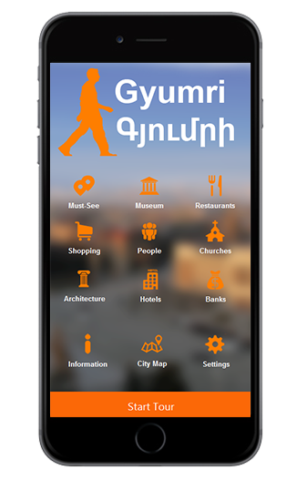
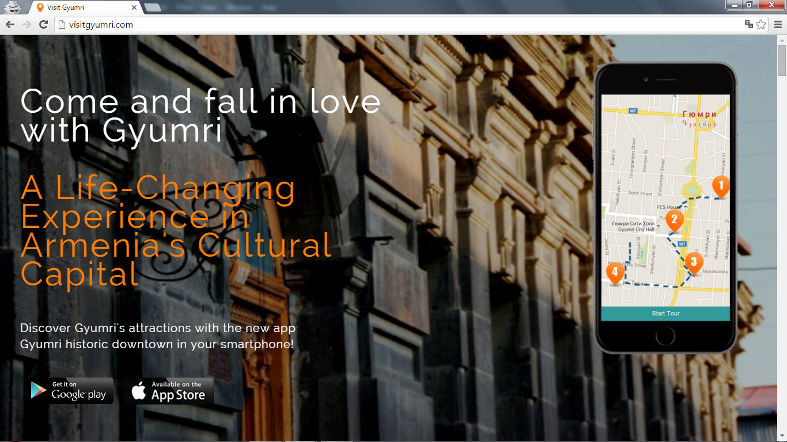
All-in-One Solution

Slide 8
Awesome Features
Easy Navigation build your tour app with user friendly interface quick and easy
Unlimited real time content updates don’t spend money on printing materials each time the content changes, instead update your content whenever and wherever needed
Custom Branding make your brand vivid in the app and market your products and services
Social Sharing let your tourists spread the word about how awesome is your location and your services
Google Map and Image Map finding directions is no longer a problem even for offline tourists
Multi-Platform App your mobile app presenting your products and services is available for Android and iOS users
Marketing Website market your city or business through the website and engage more people
Audio Materials give your tourists best experience to self guide
Multi-Language Content language is no longer a barrier for foreign tourists to visit you
Support for App Submission we will guide you through the app submission and publishing process
In-App Ads advertise other local businesses in your app and generate income
Reports and Tracking get reports and statistics on your tourists numbers and track them more easily than ever
Multiple tours in one app

Slide 9
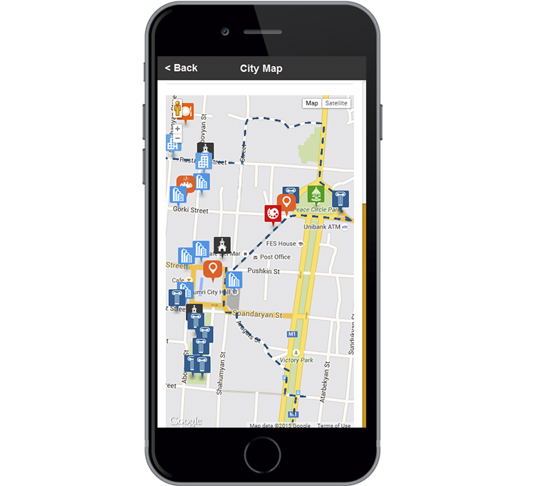
How Tourism Can Benefit from Technology
Fast and easy way to create the tour
No language issues for guides
Offline maps (no data charges when on roaming)
All info in a smartphone
Audio guides
Media files inside the app
Clear routes designed for tourists
Opportunity to advertise local businesses and generate income

Slide 10
Who is the app for?

Slide 11
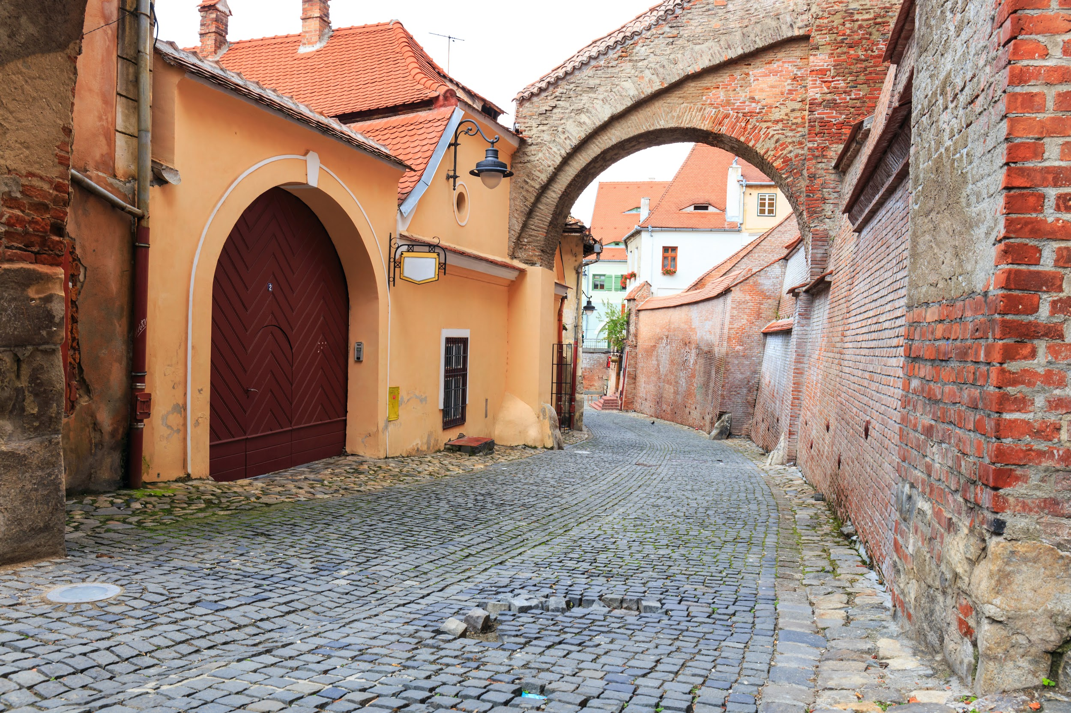
Small Town or Neighbourhood Walks

Slide 12
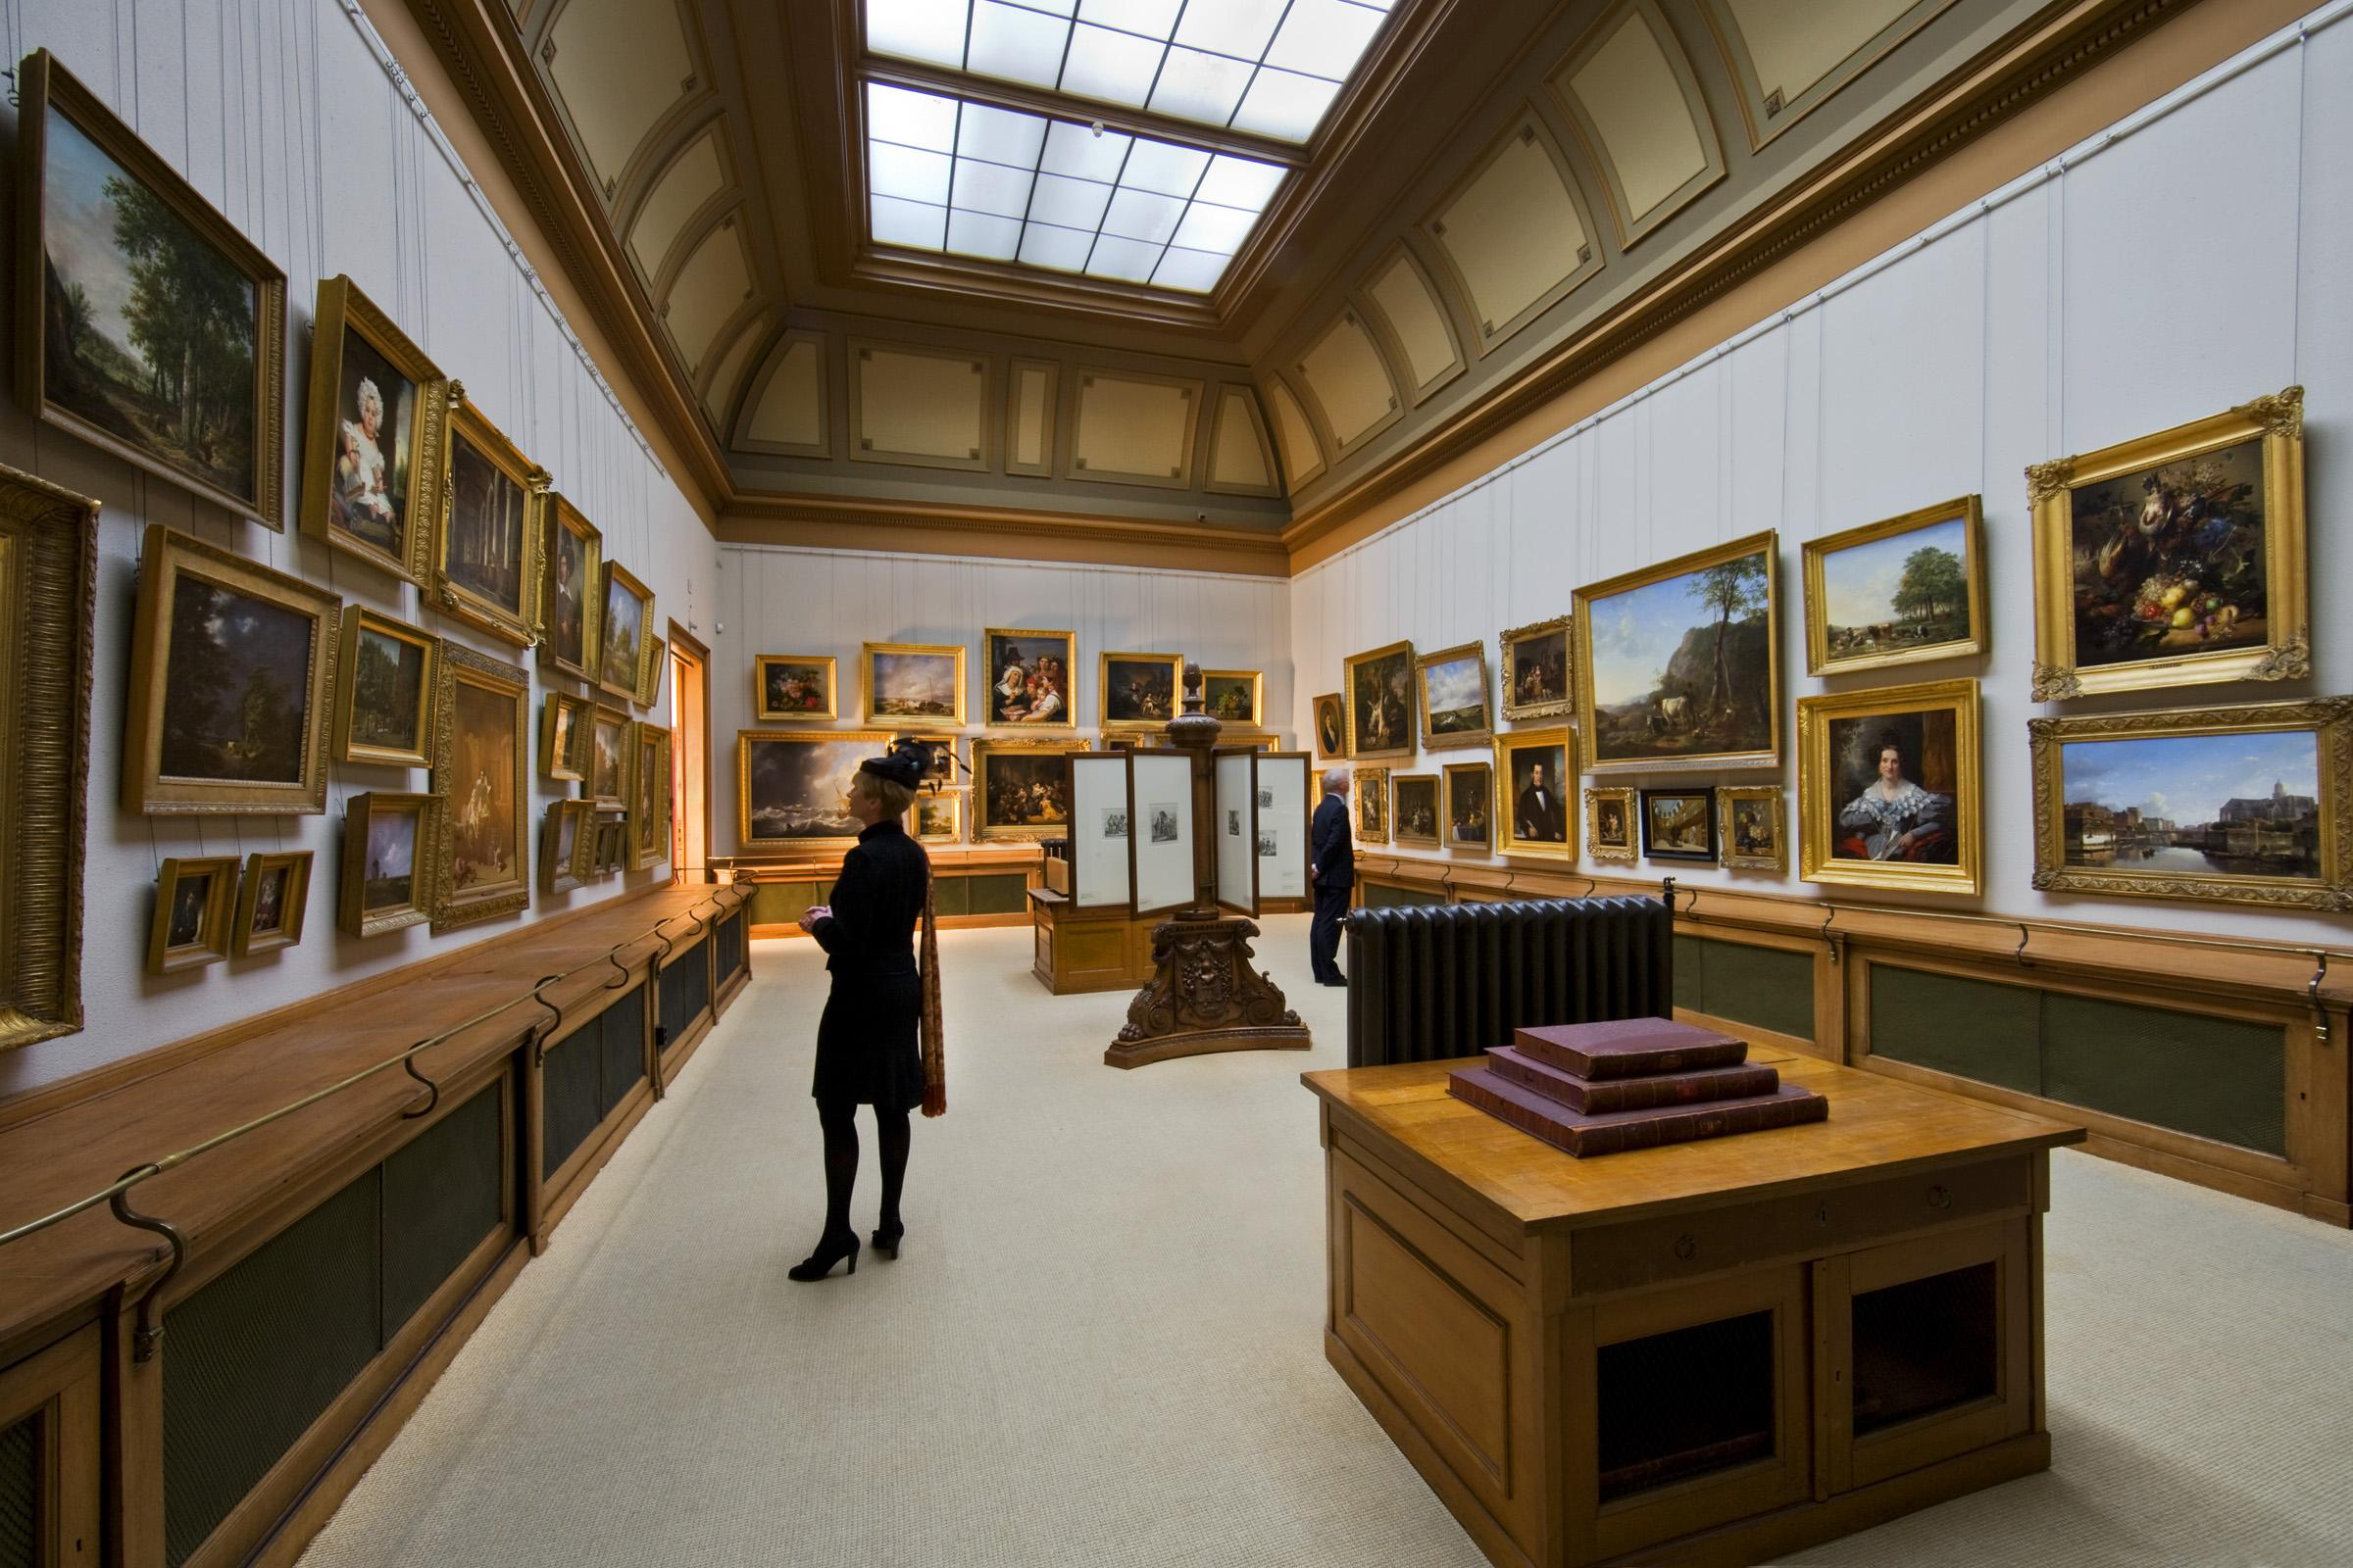
Museum/Gallery Tours

Slide 13
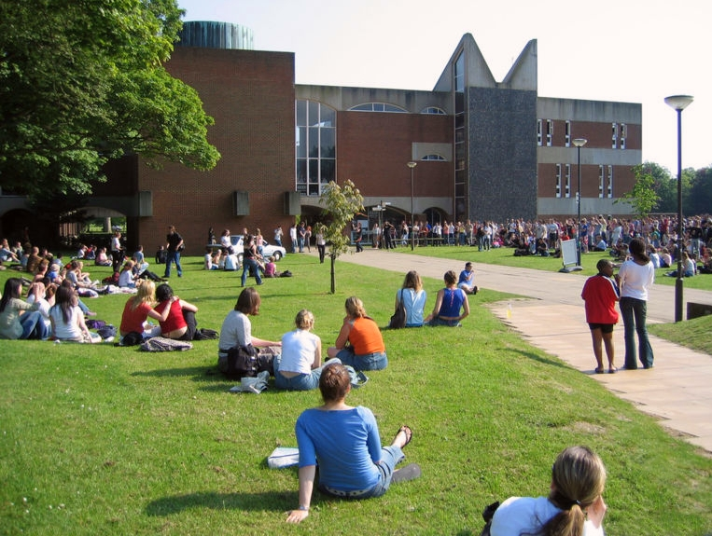
University Tours

Slide 14
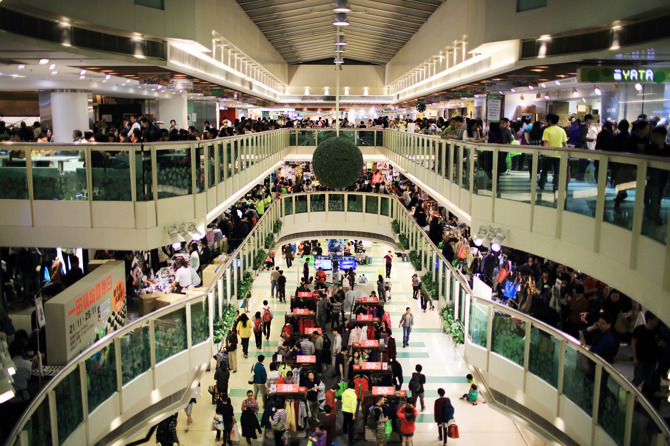
Shopping Mall Tours

Slide 15
Biking Tours

Slide 16
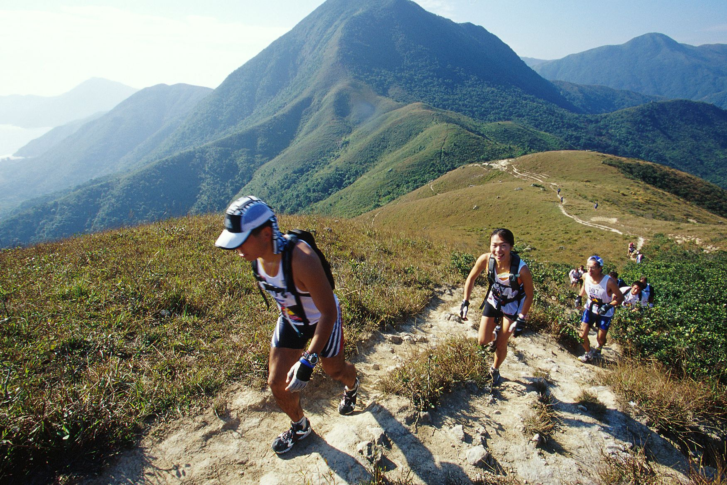
Hiking Tours

Slide 17
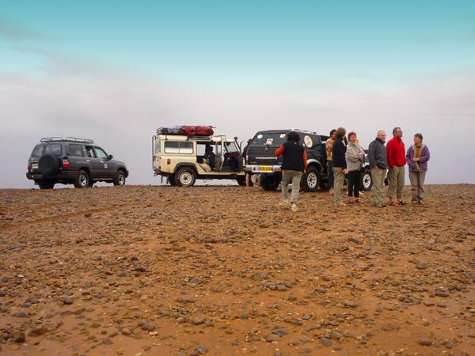
Driving Tours

Slide 18
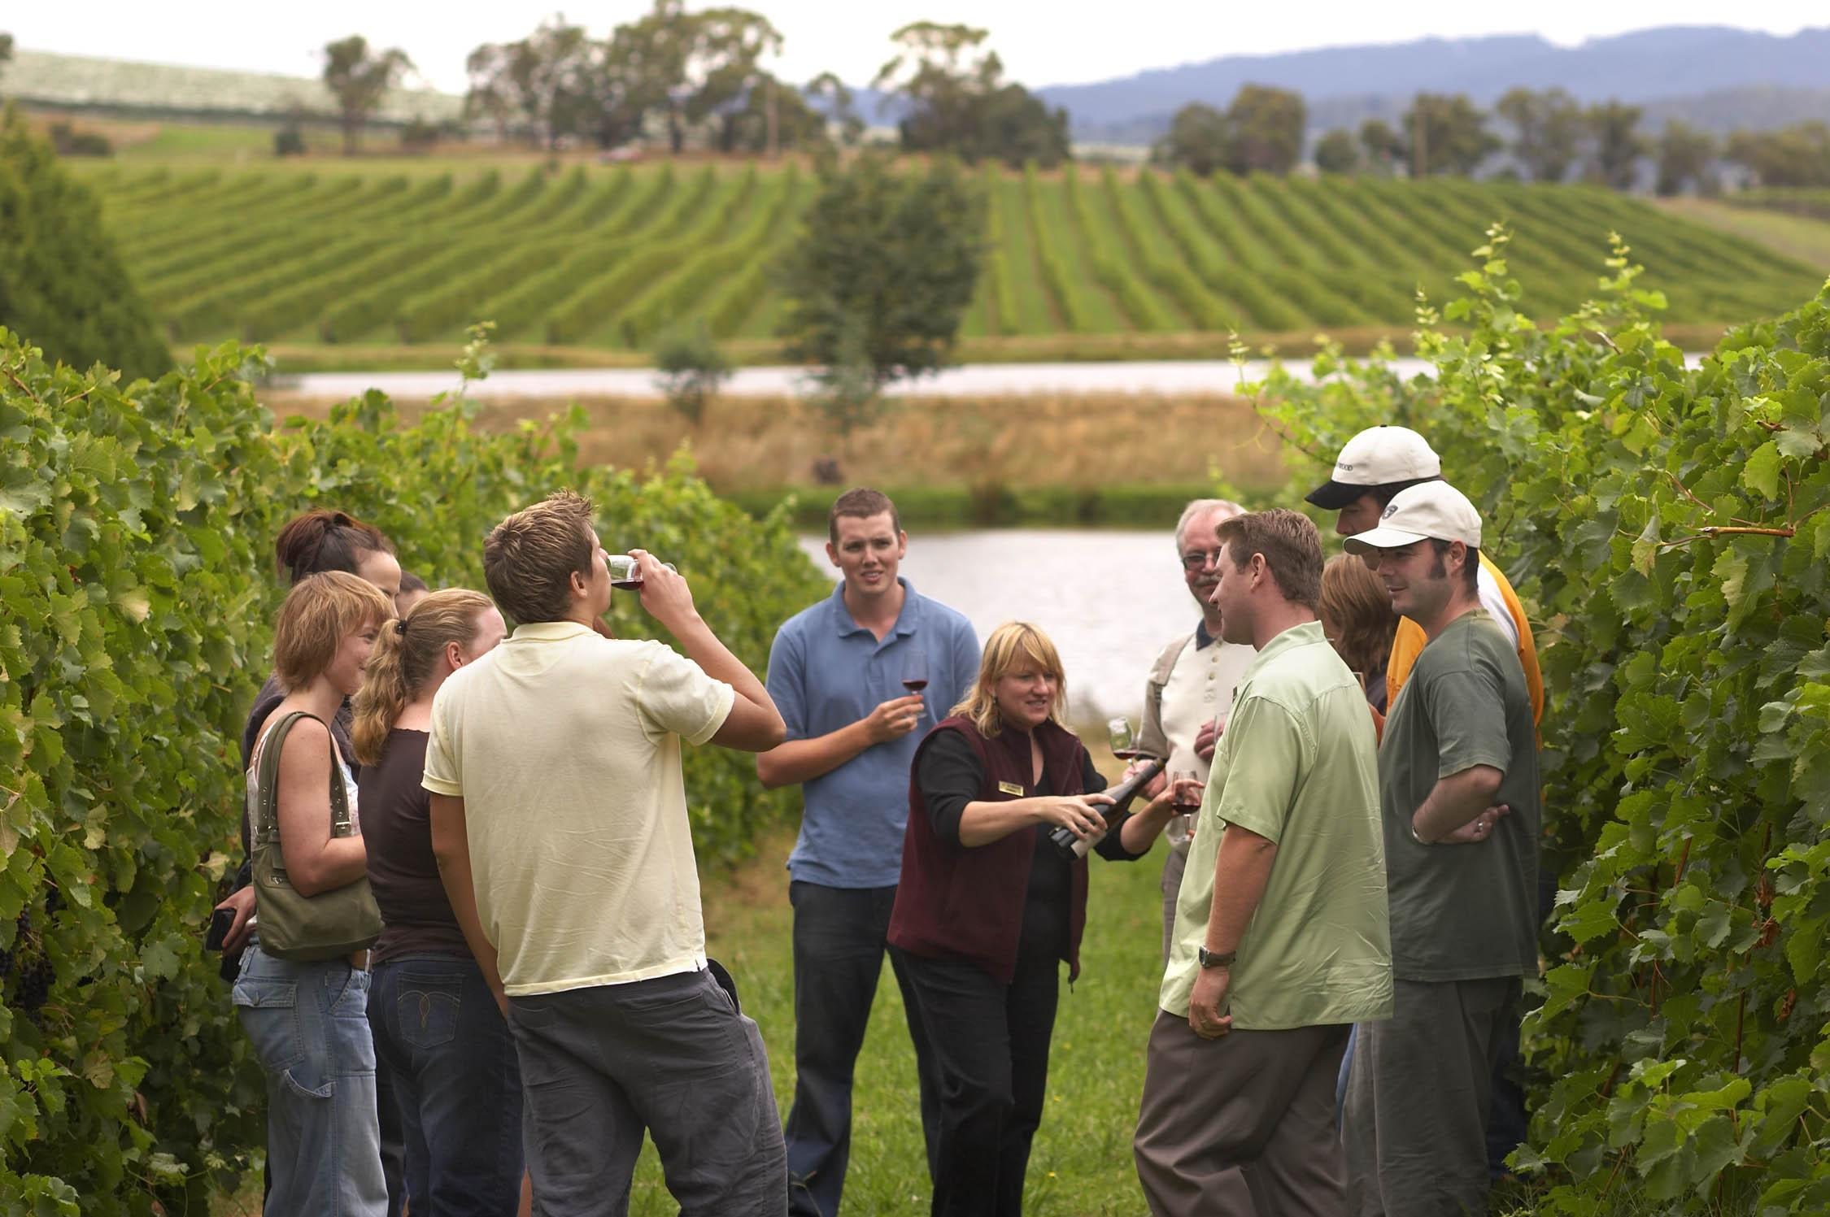
Winery Tours

Slide 19
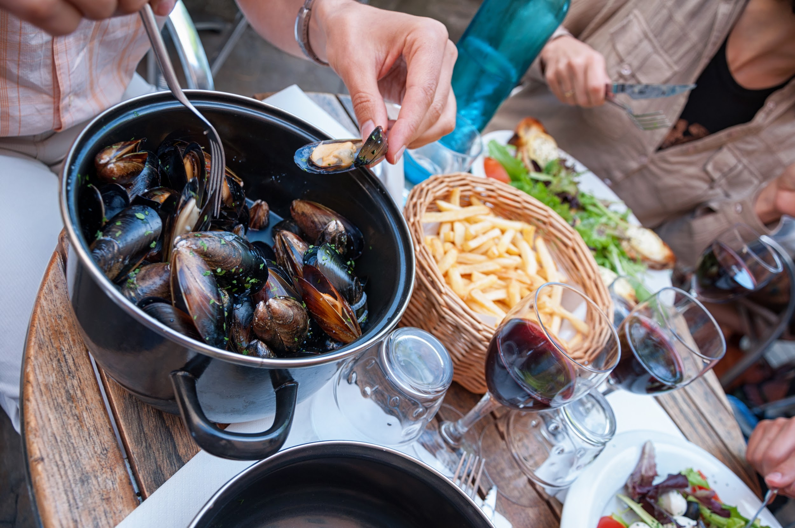
Food Tasting Tours

Slide 20
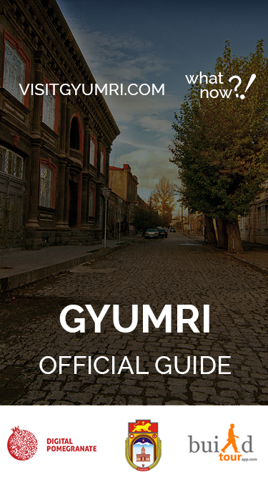
Example of our work
Coming Soon

Slide 21
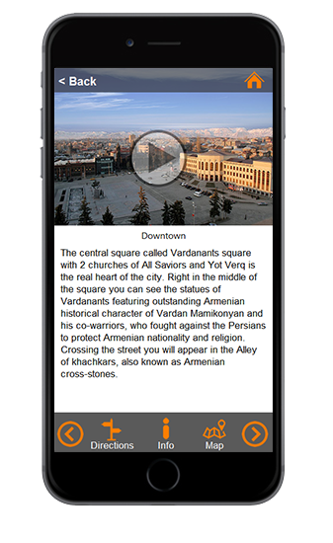
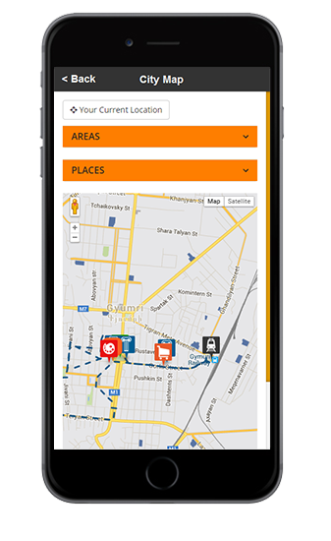
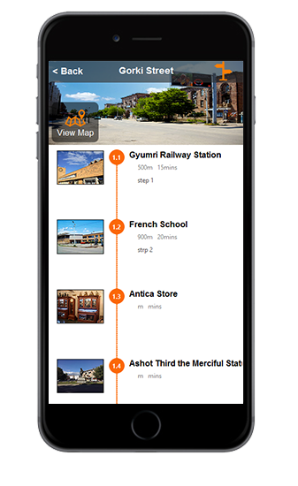
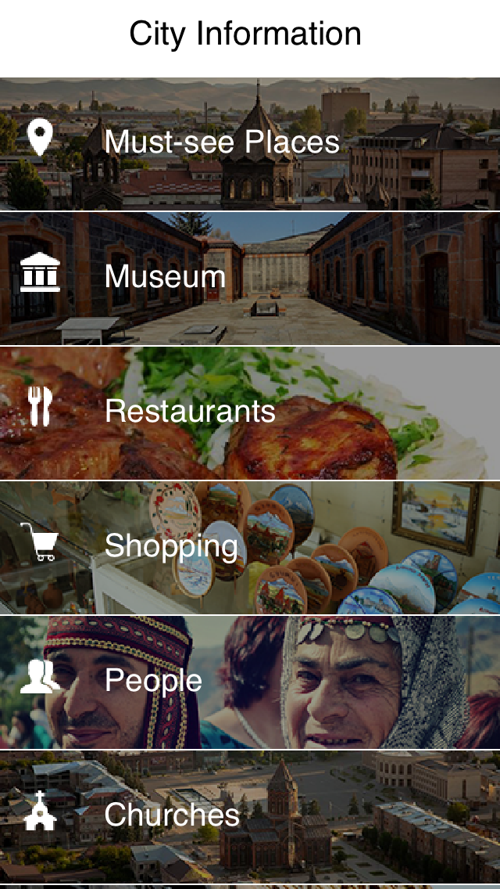
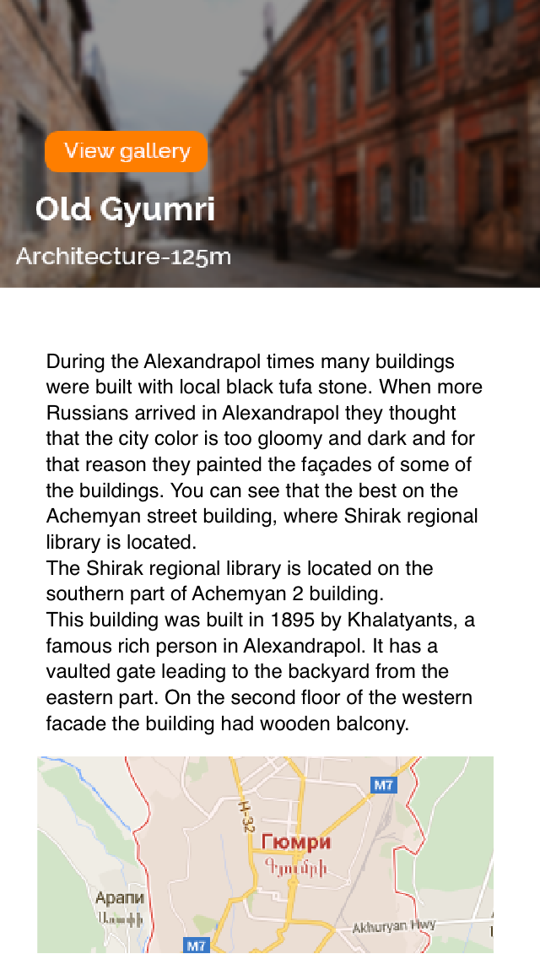
Gyumri App Screenshots

Slide 22
First Campaign Over 100 participants a day
https://www.youtube.com/watch?v=gchNEaKgWPE
https://www.youtube.com/watch?v=MfFNyOZSHFo

Slide 23
Thank you

