Slide 1
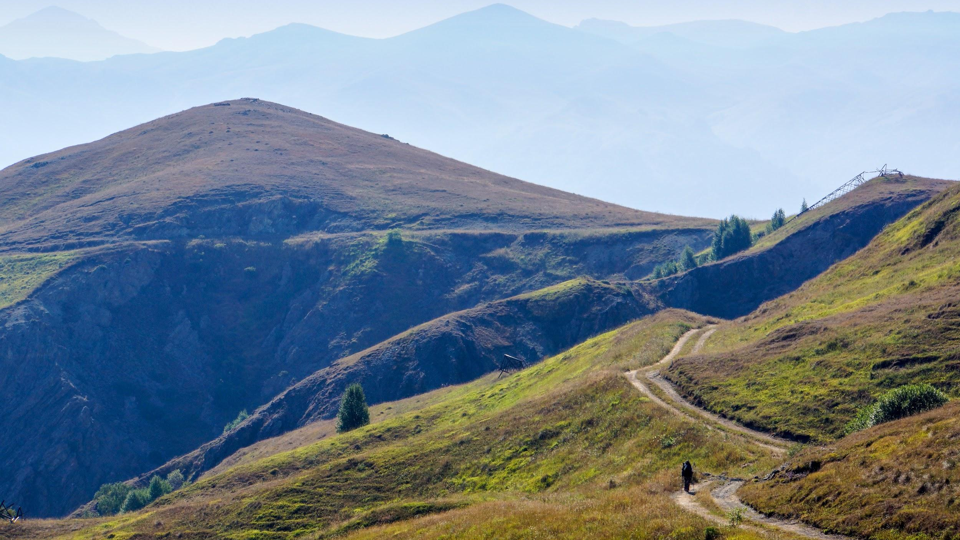
TRANSARMENIAN TRAIL
The newest long-distance hiking trail.
Here in Armenia.
Search Transarmenian Trail on Facebook!

Slide 2
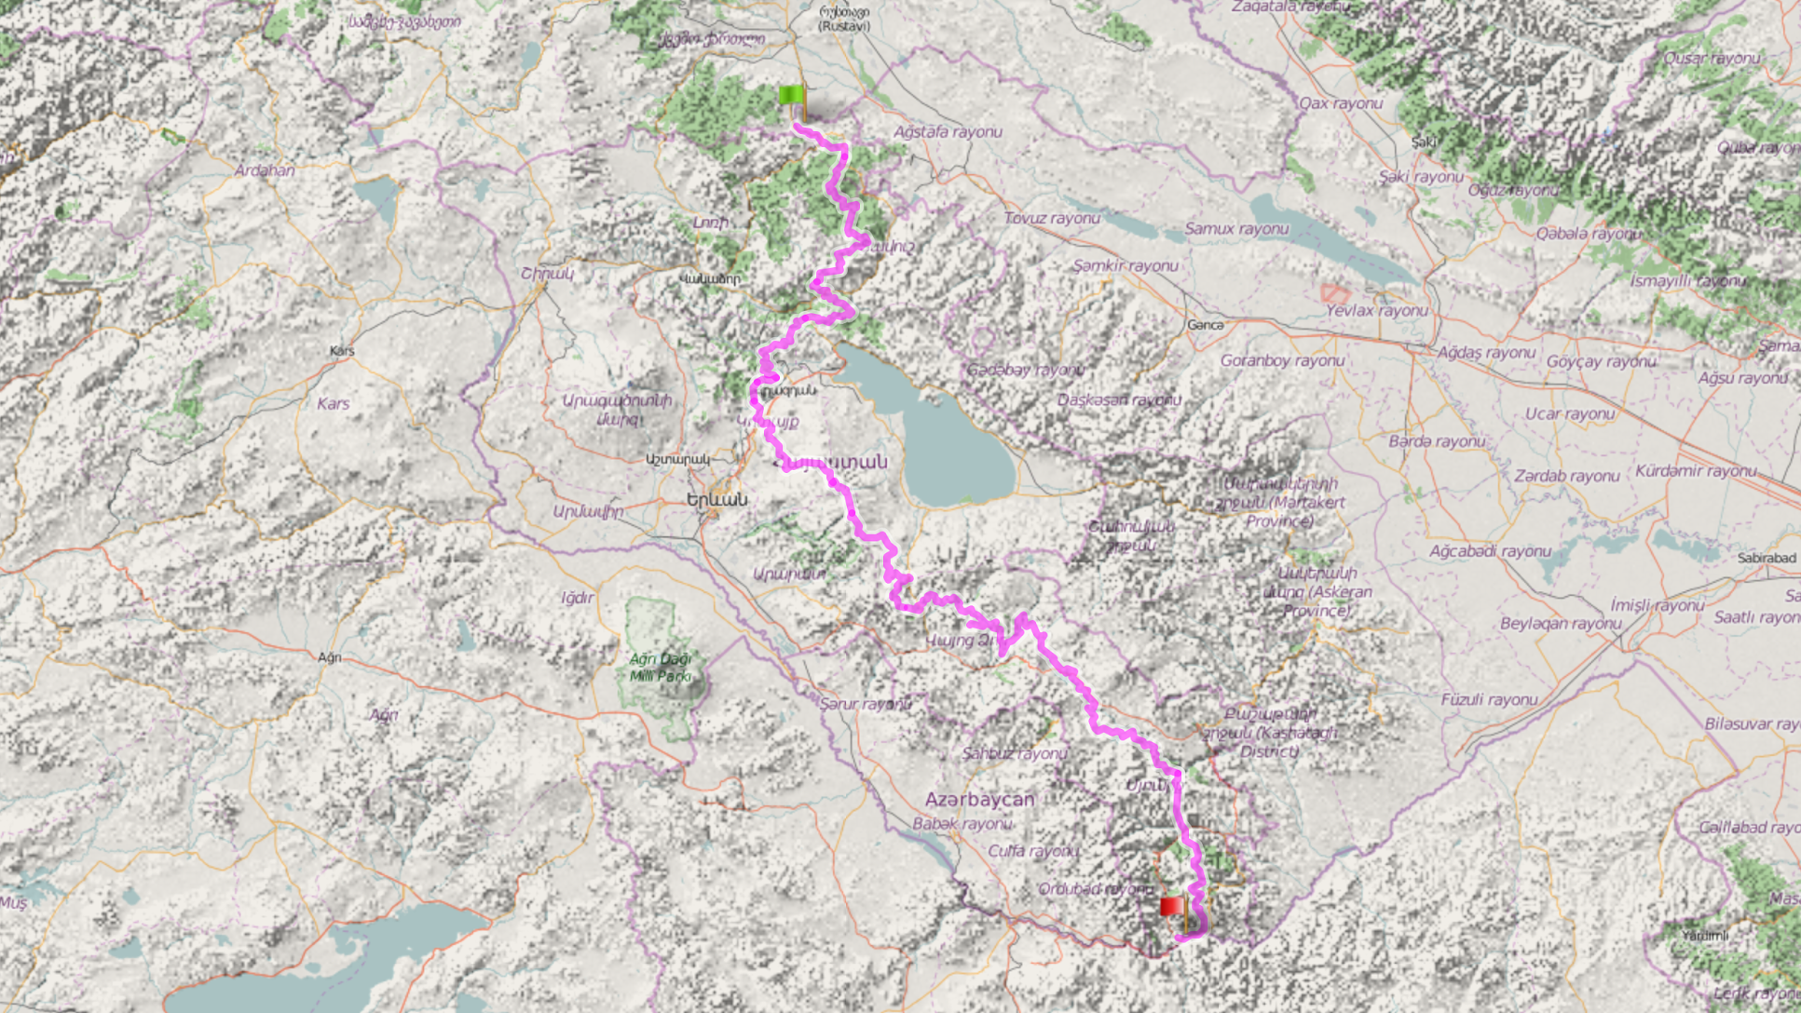
Full TAT map
From the brochure

Slide 3
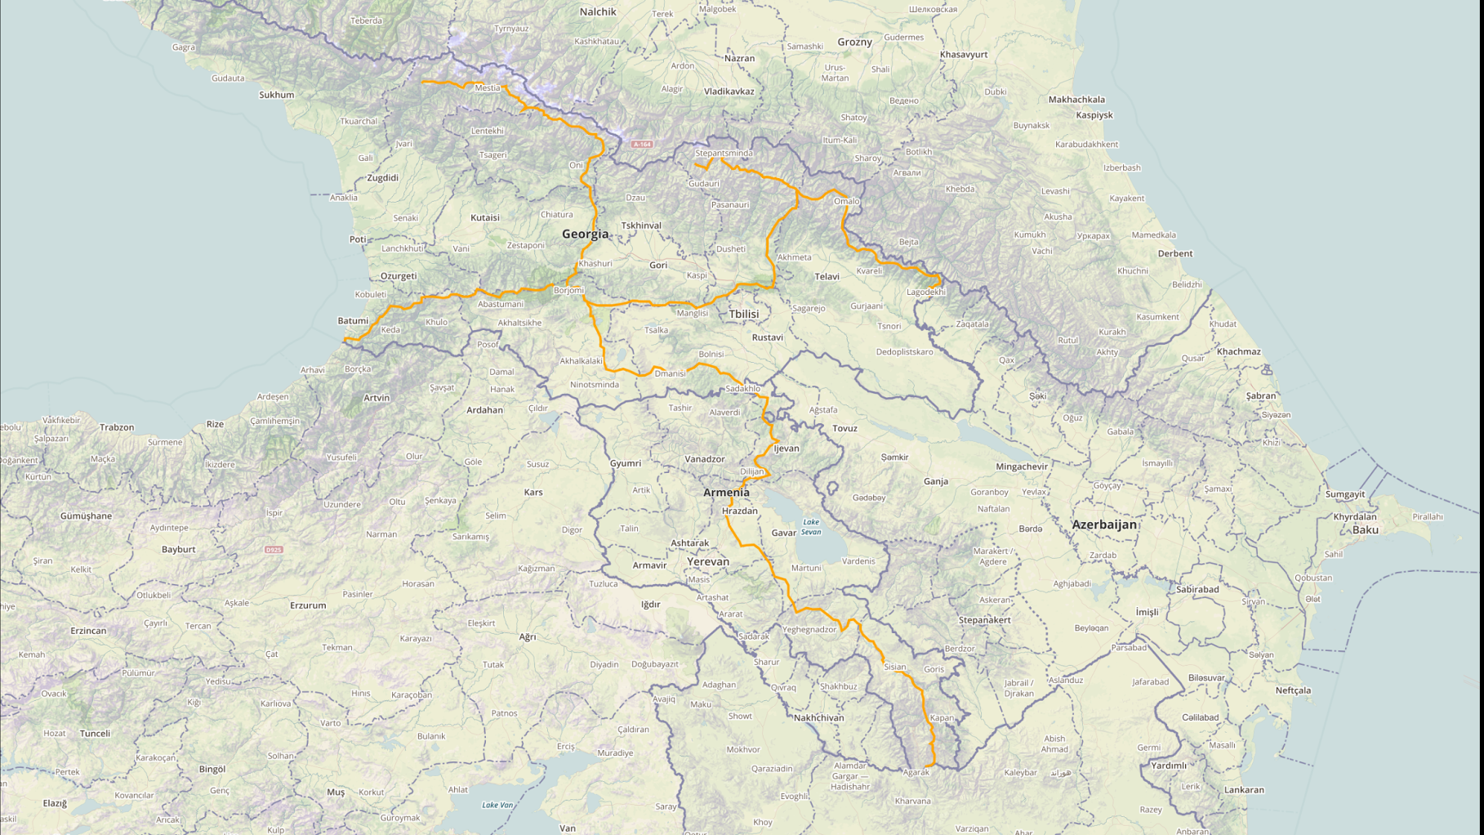

Slide 4
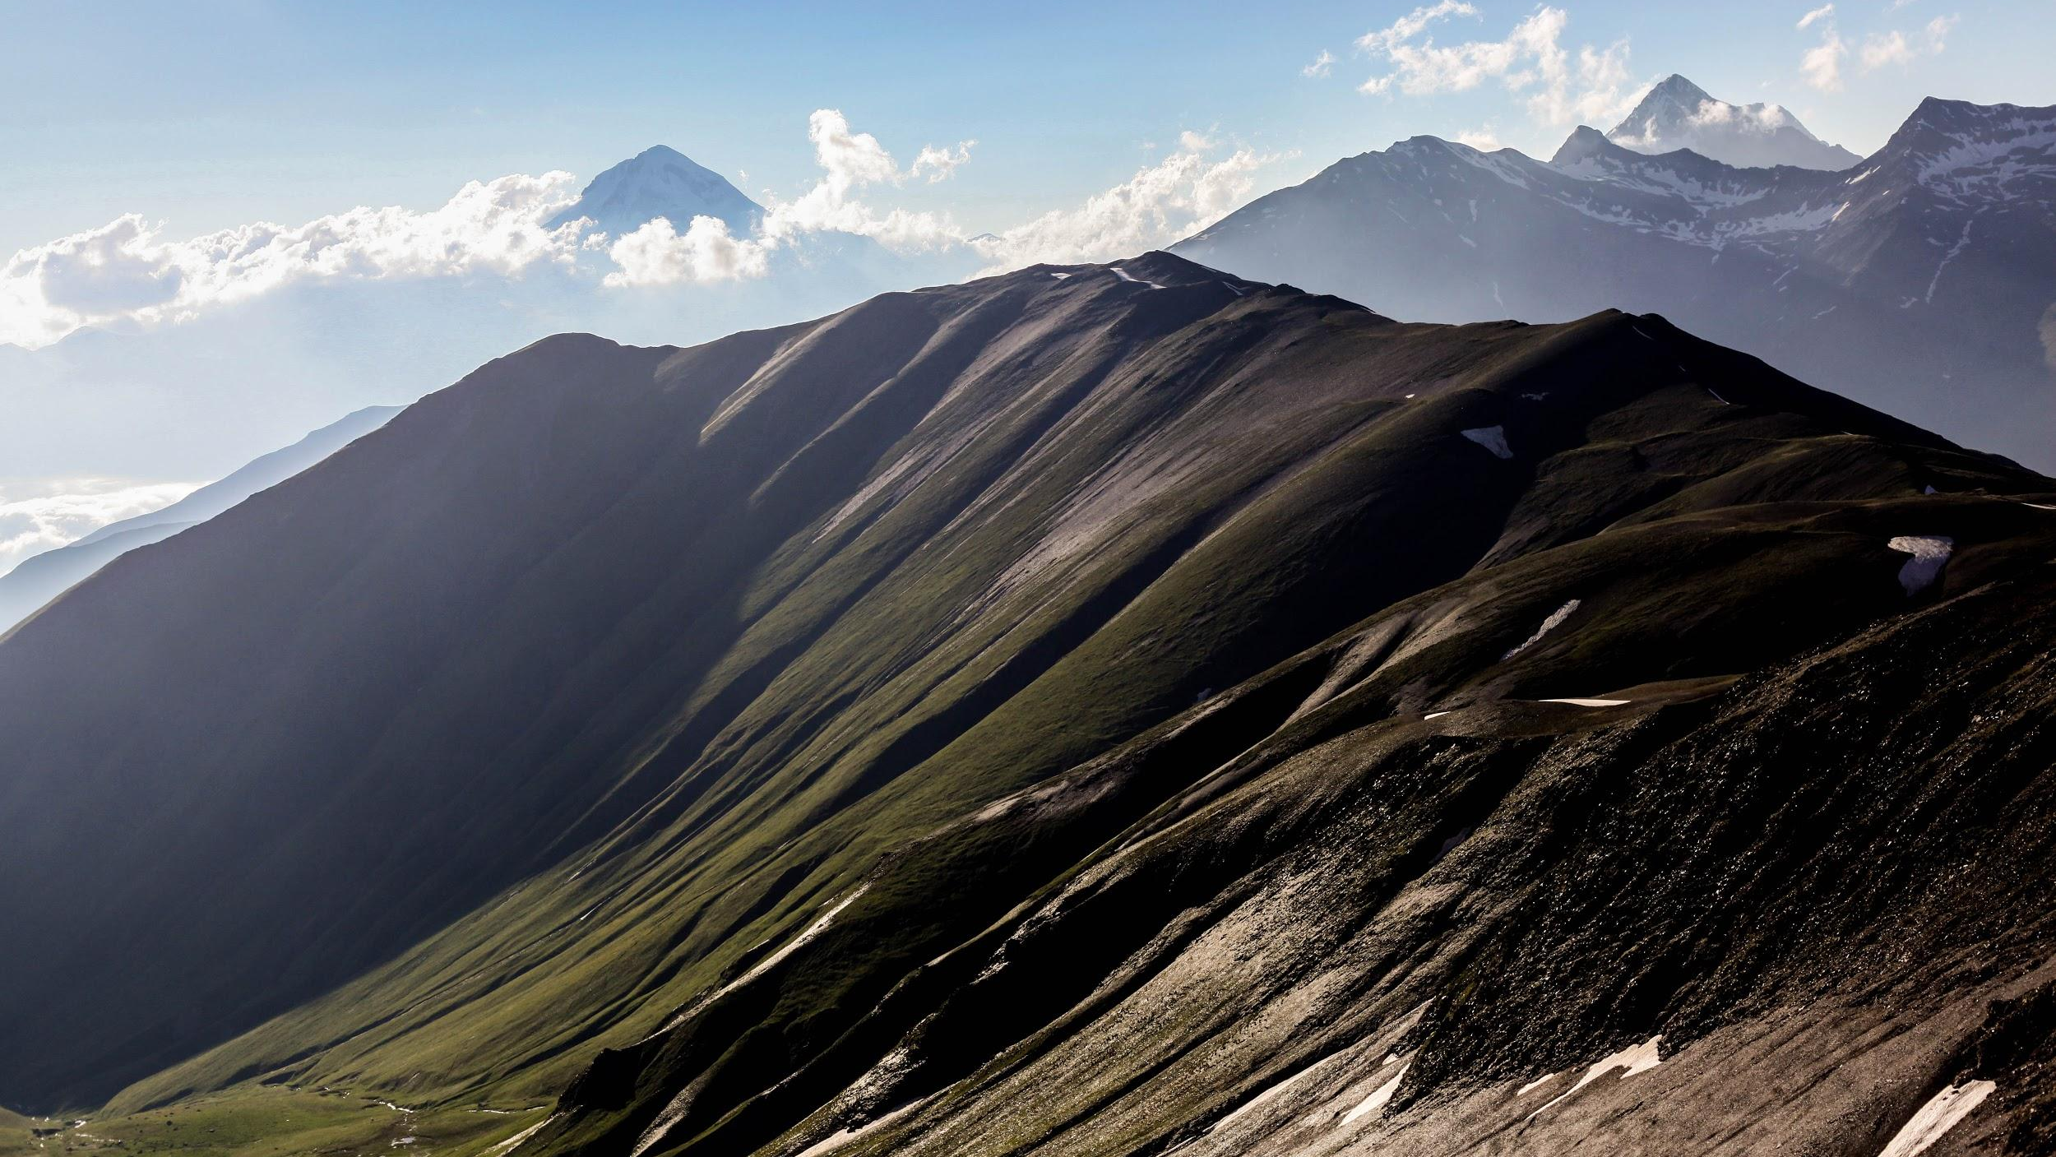
TRANSCAUCASIAN TRAIL
Our bigger, shared vision. Across borders.
Search Transcaucasian Trail on Facebook!

